Slide 1

Wellbeing in Later Life
Prof Anne Hendry
Honorary Secretary, British Geriatrics Society
Director IFIC Scotland

Slide 2

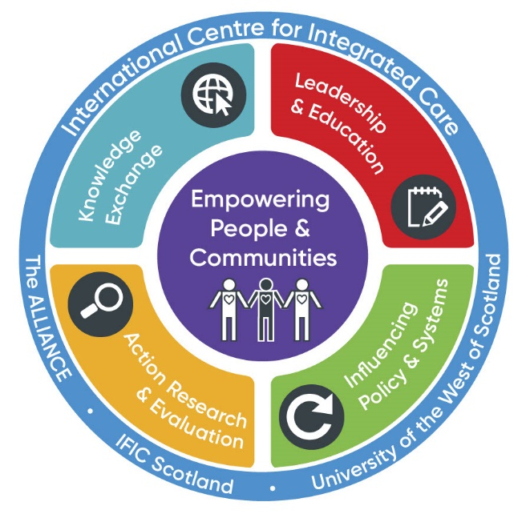
Mission:
Co-creating a healthier future with individuals and communities by developing courageous and compassionate leaders and practitioners with the knowledge, skills and confidence to design, deliver and evaluate people-centred integrated care.
https://integratedcarefoundation.org/ific-scotland

Slide 3
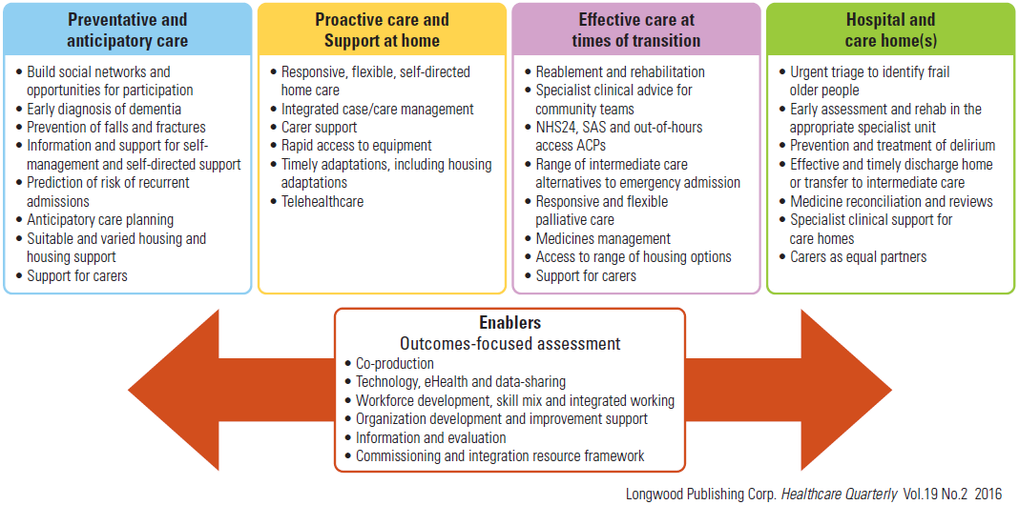
Reshaping Care for Older People in Scotland

Slide 4
Reshaping Care for Older People in Scotland

Slide 5
Four Themes
“I want to have fun and enjoy myself”
“I wish to remain connected to my community and friends”
“Don’t talk about me without me”
“I wish to be able to contribute to society for as long as I want and to be treated with respect”

Slide 6
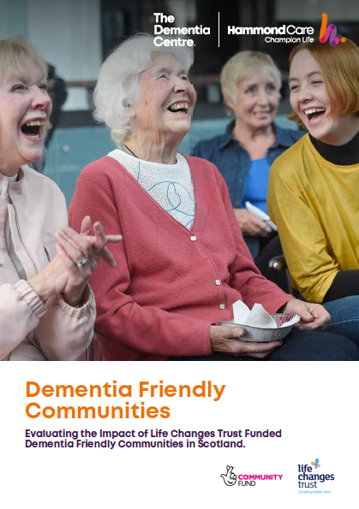
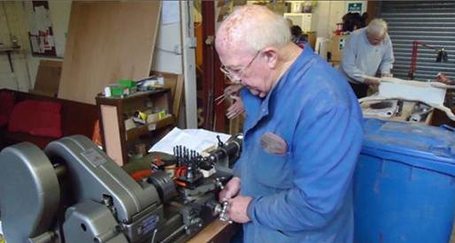
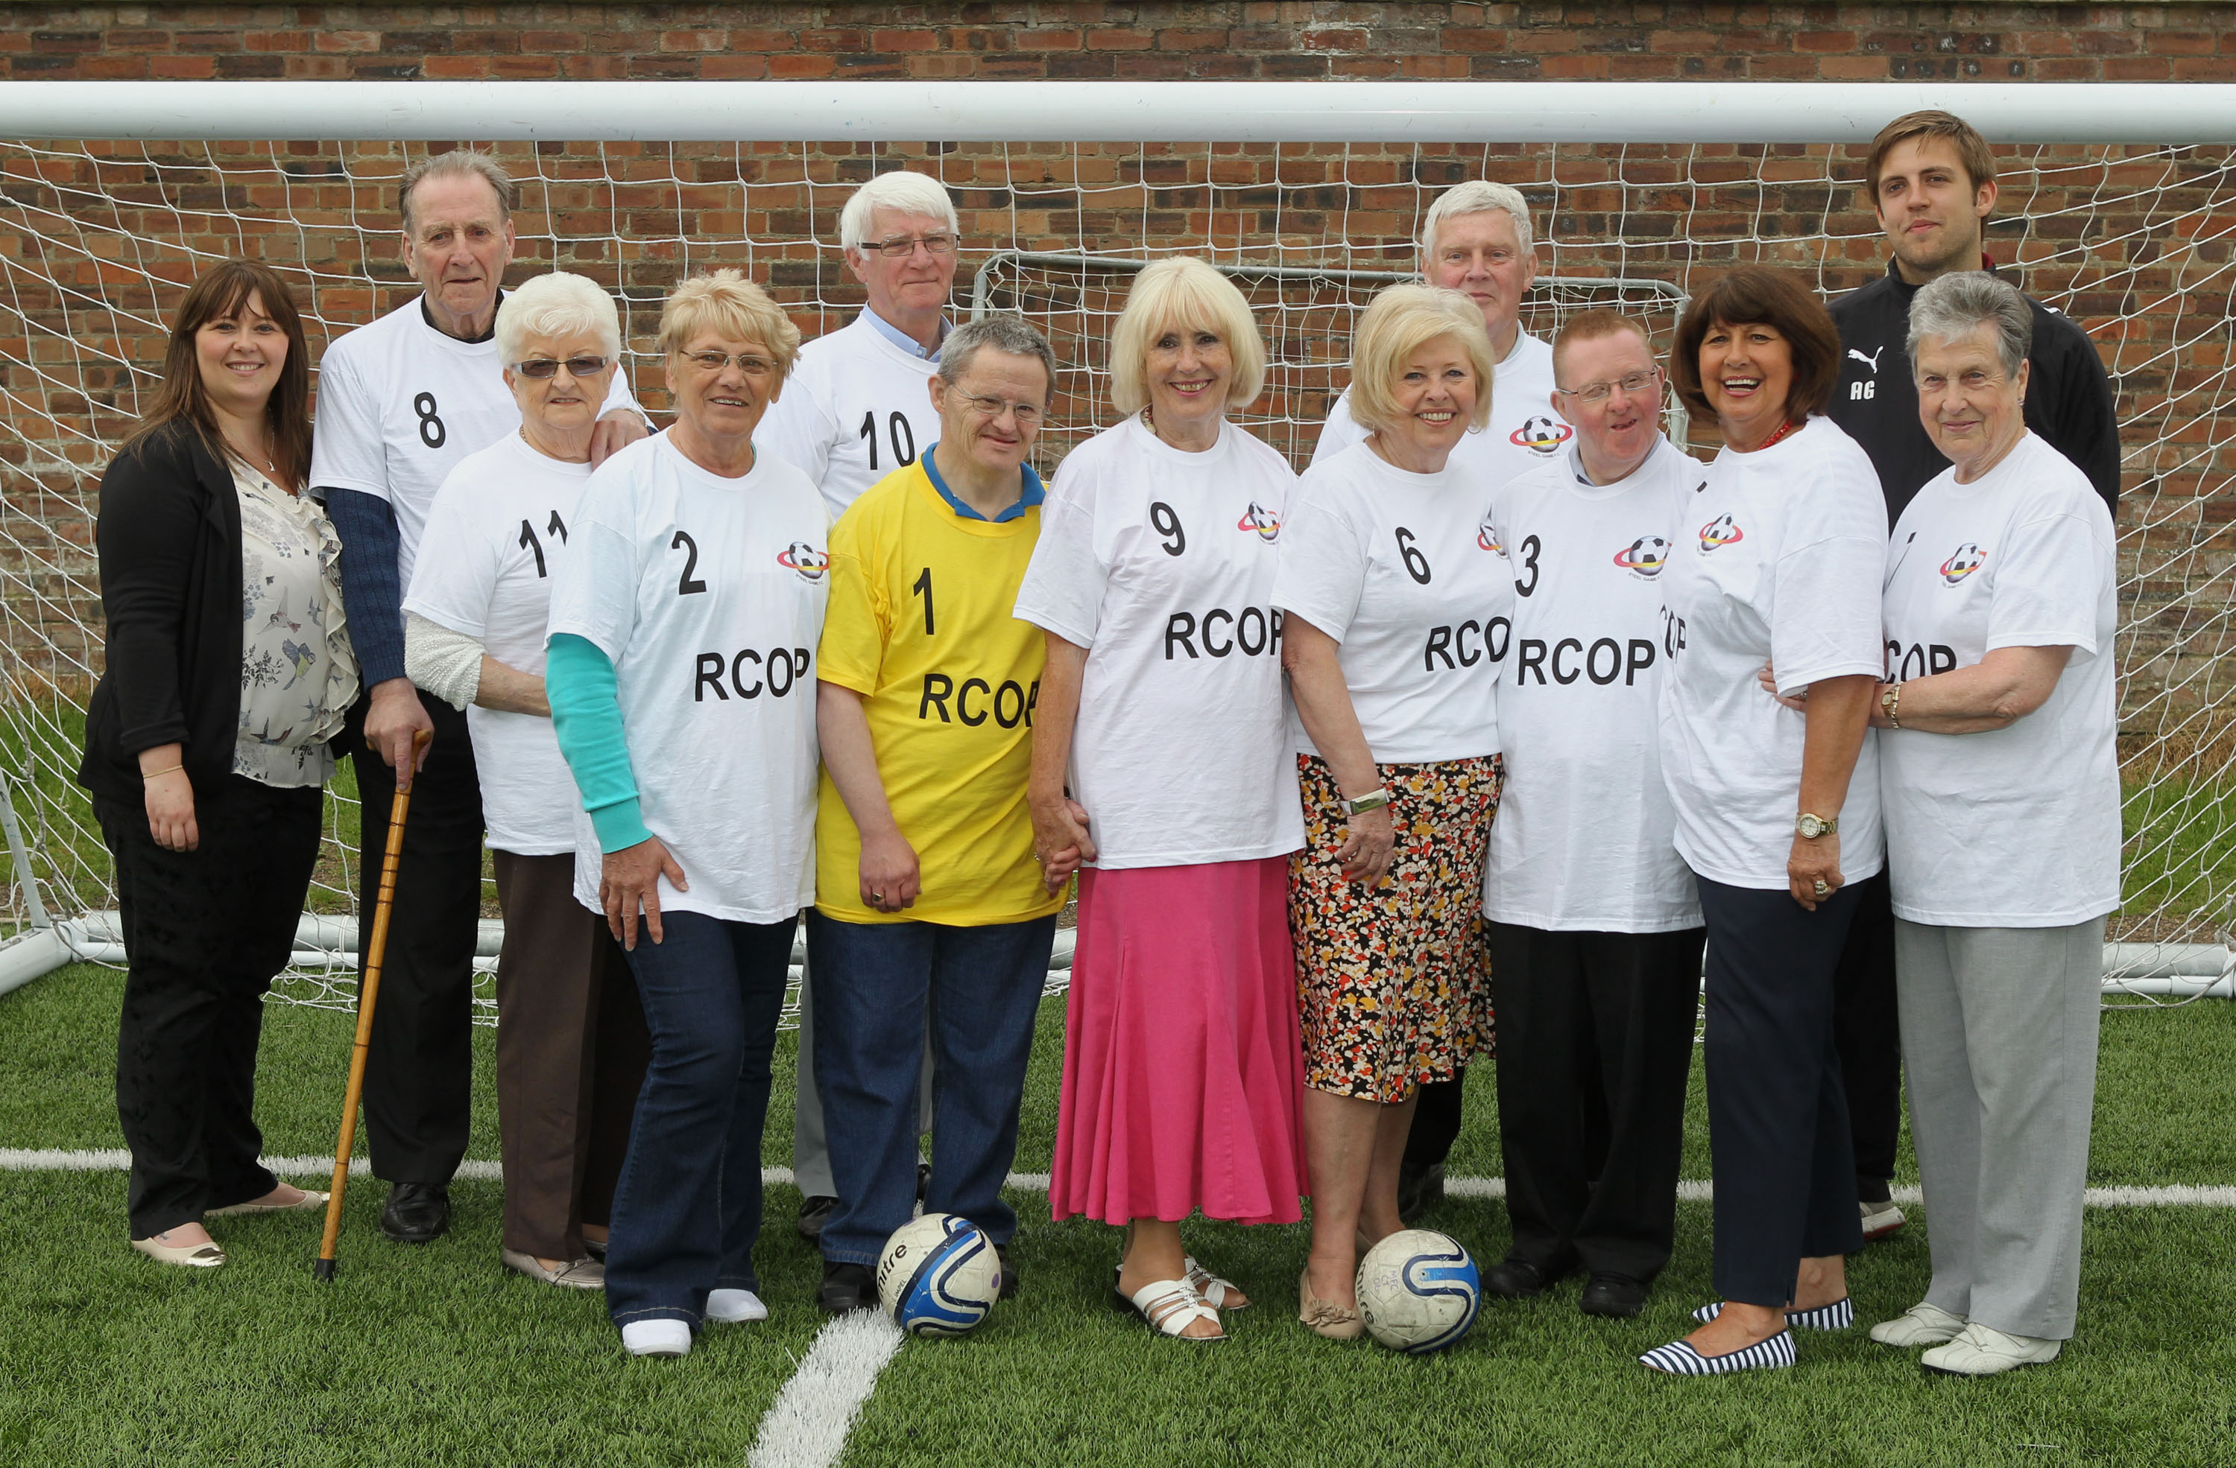


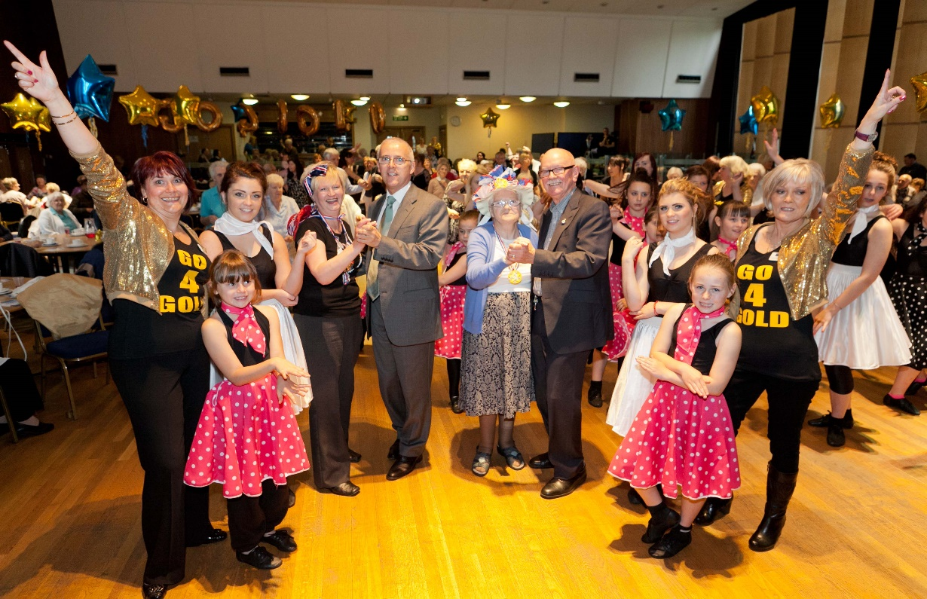
Community Support to help people stay well

Slide 7
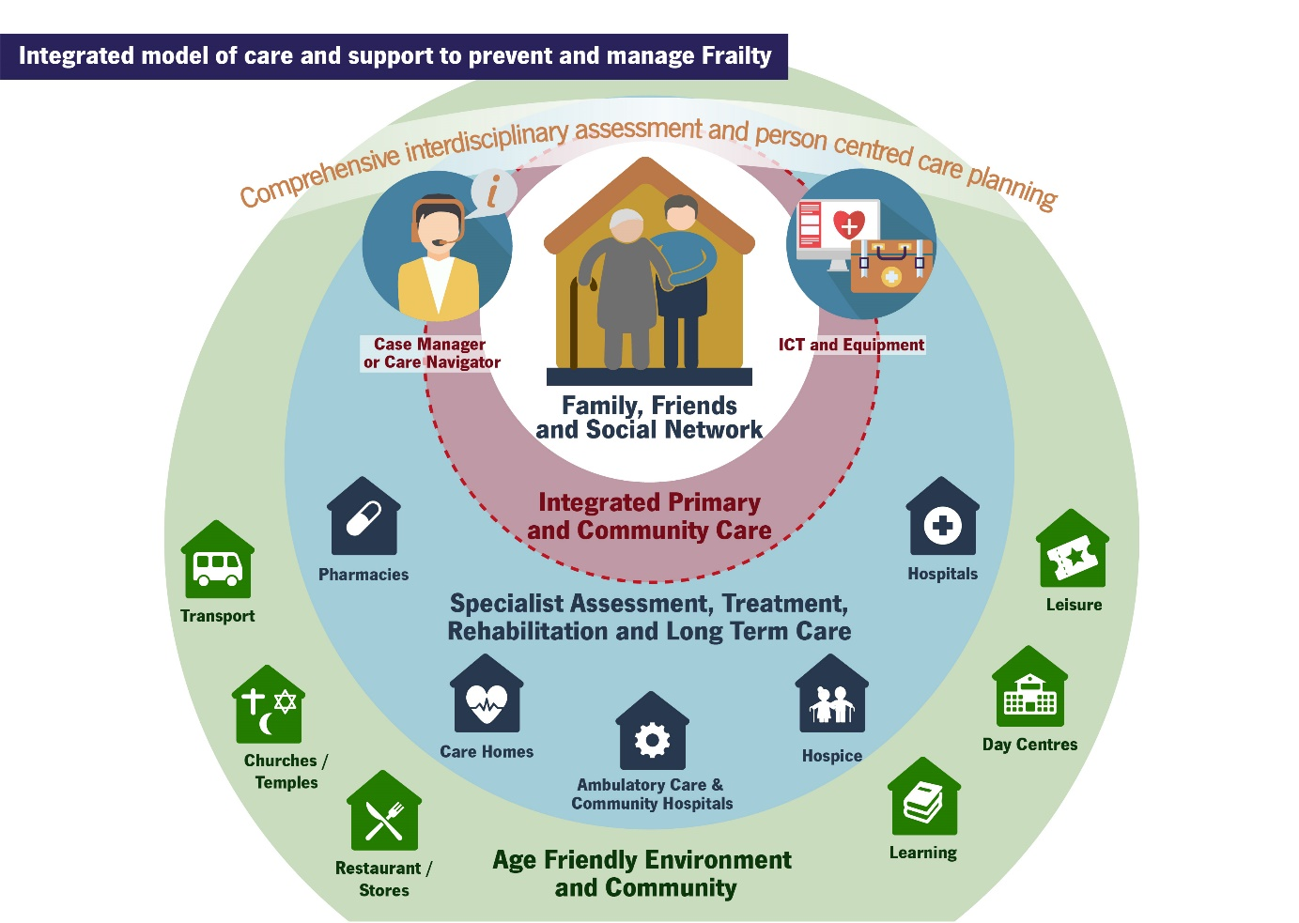
https://www.advantageja.eu/

Slide 8
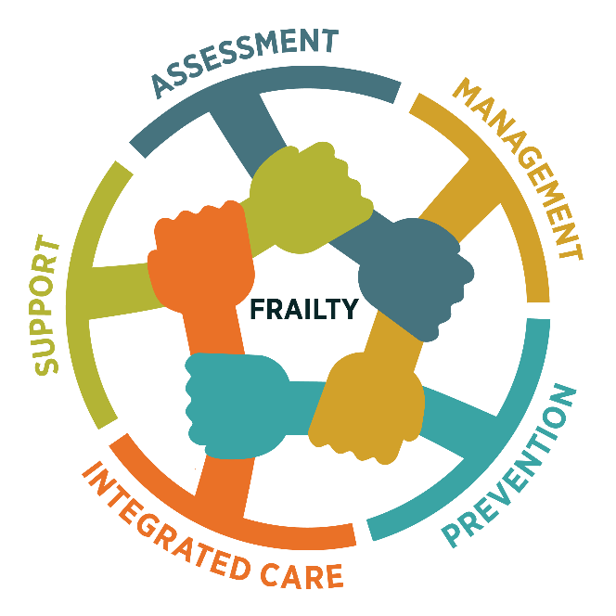
Preventing Frailty
Start active ageing recommendations at mid life
Promote a Mediterranean diet
daily protein >1-1.2 g per kg
Asses risk for malnutrition
Mini Nutritional Assessment
Target BMI < 30
Low intensity exercise (endurance, ﬂexibility, balance, resistance training) in sessions of 30 to 45 minutes, three times per week.
Vitamin D supplement if increased risk for falls / fracture

Slide 9
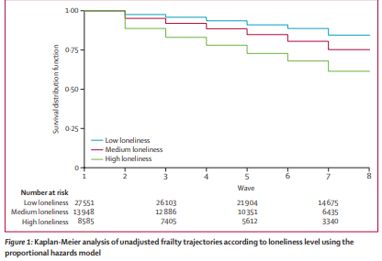
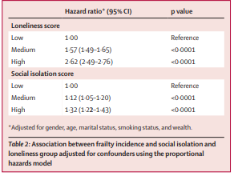
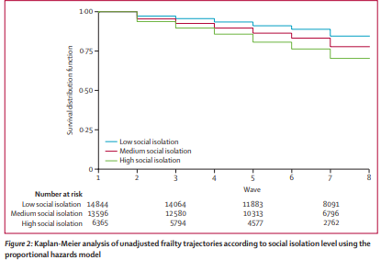
Loneliness, Social Isolation and Frailty
Davies K, Maharani A, Chandola T, Todd C, Pendleton N. The longitudinal relationship between loneliness, social isolation, and frailty in older adults in England: a prospective analysis. The Lancet Healthy Longevity. 2021; 2:(2)E70-E77 https://doi.org/10.1016/S2666-7568(20)30038-6

Slide 10
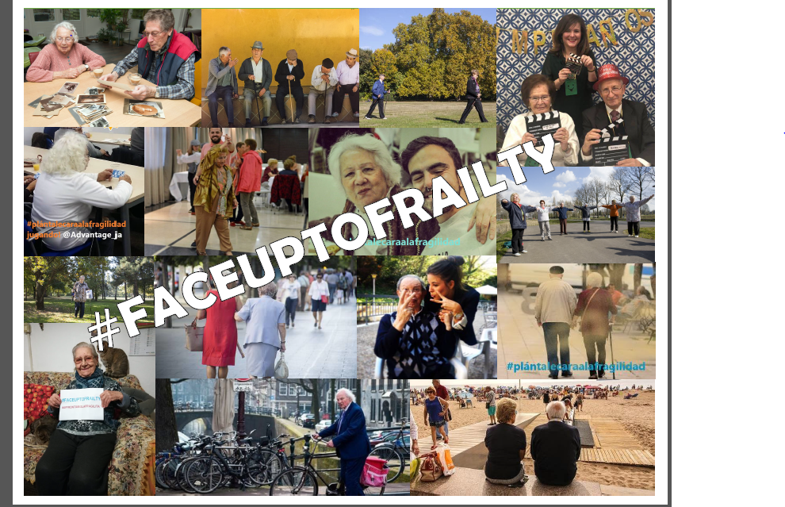

Slide 11
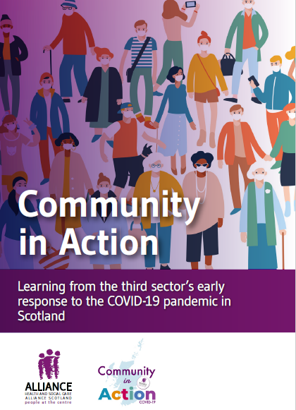

Reduced and disrupted access to services
Loss of agency; loneliness and isolation
Deconditioning
‘Much poorer mobility and weight gain has made it even harder to do normal everyday things like accessing the upper floor of my home, hanging out washing, doing a bit of gardening.’
‘Mum used to catch buses to the next town and walk across town and back home on the bus. Now she is struggling to walk down the path.’
Local resilience hubs
Volunteering
Compassionate Communities

Slide 12
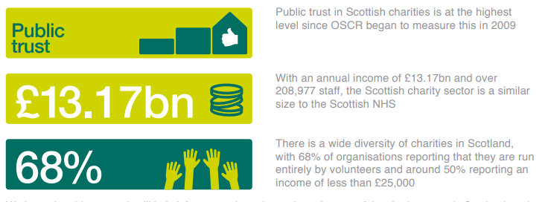
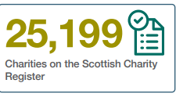
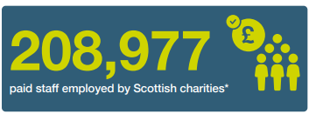
Contribution of the Voluntary Sector
Third sector is involved in nearly every area of local life – housing, advice, support, sports, representation, arts, education, health, care, environment and more.
Third sector interfaces (TSIs) offer a single point of access in each local authority area in order to develop the third sector, increase social enterprise, build relationships with community planning partners and support volunteering and volunteers
positive community purpose
run by an unpaid (or mostly unpaid) committee
not set up to distribute profit to shareholders
not affiliated to a political party or a government body.

Slide 13
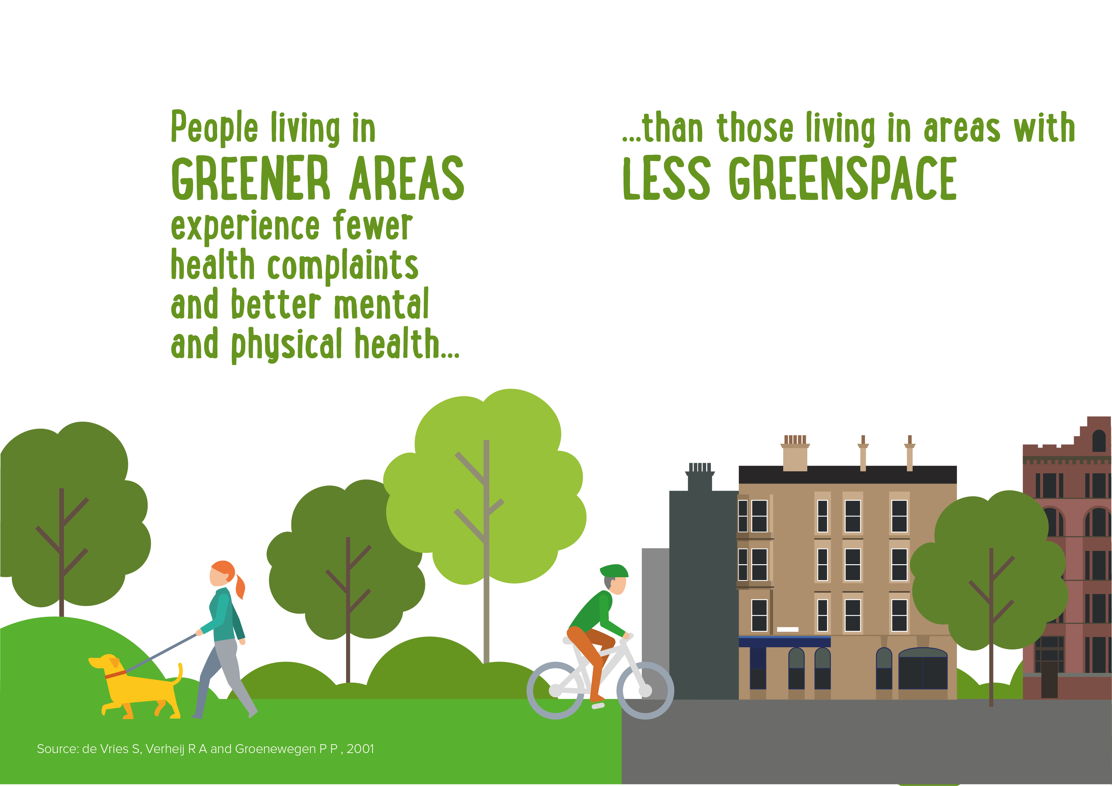

Slide 14
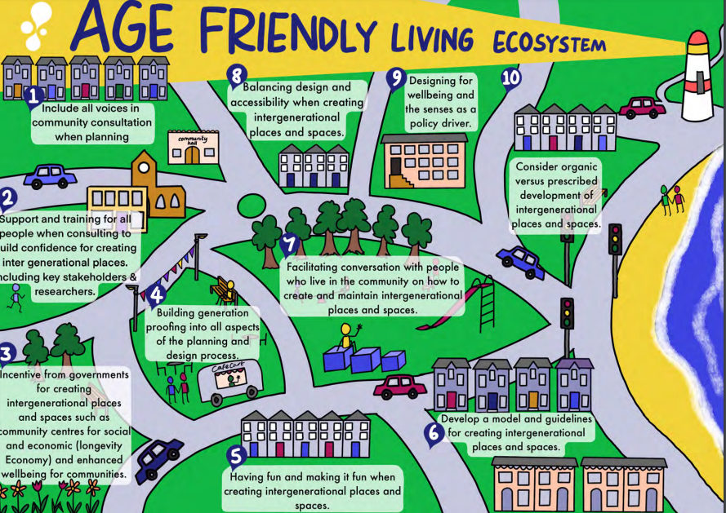
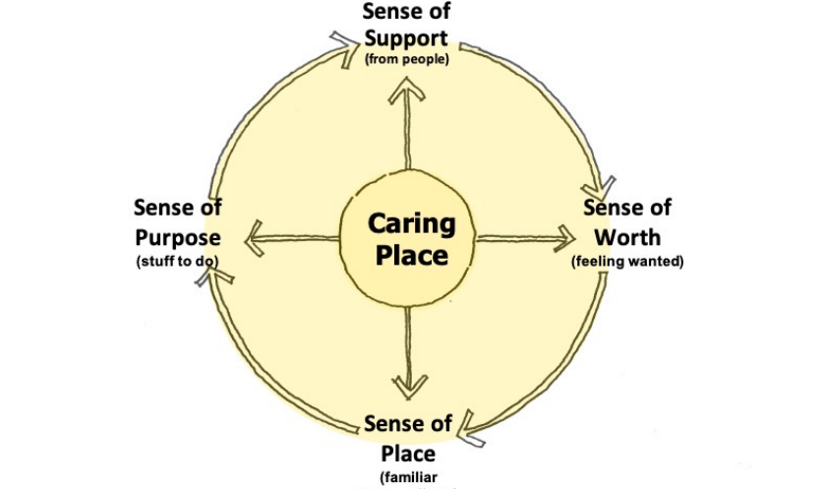
Housing, Places and Spaces
AS
Steve Malone
Architecture & Design Scotland
Intergenerational and Agefriendly Living Ecosystems (AFLE project)
Scottish Universities Insight Initiative 2021

Slide 15
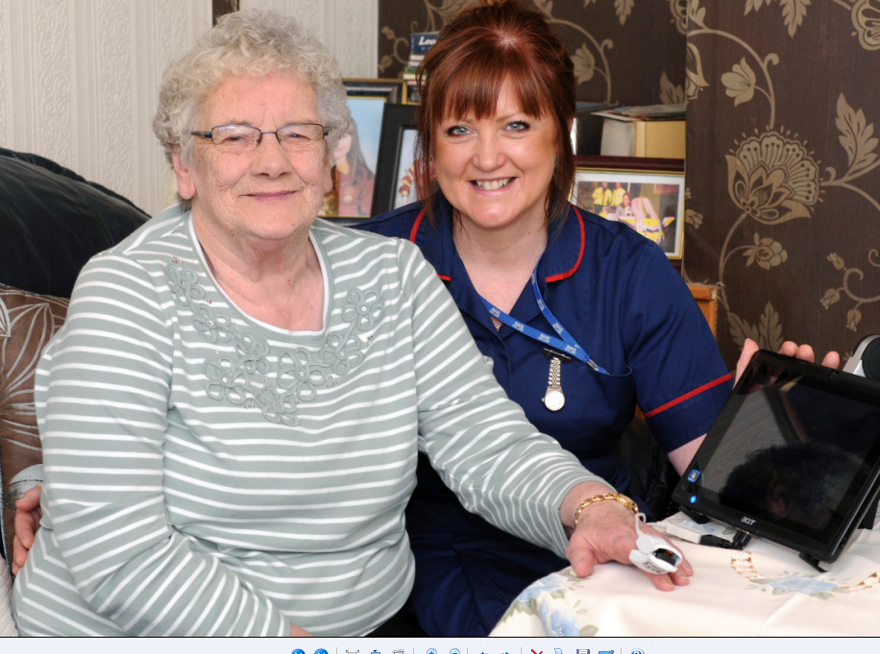
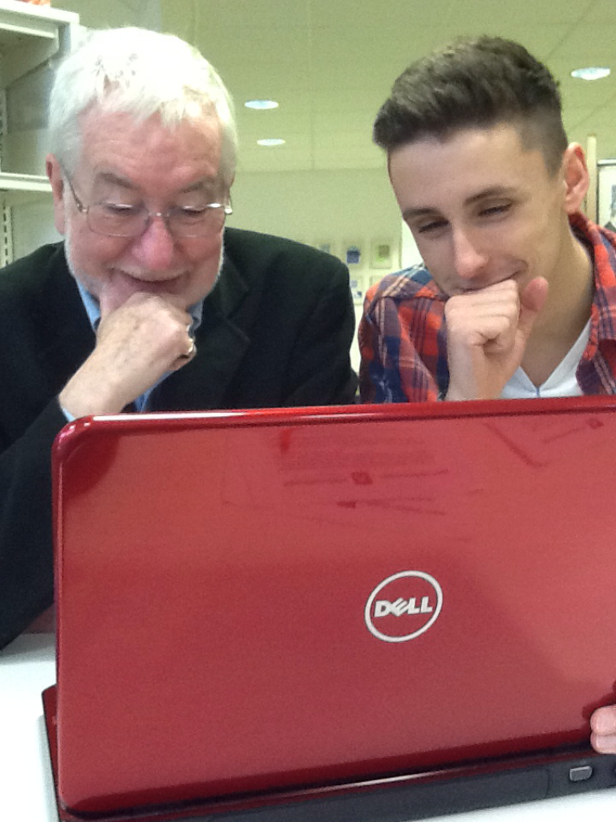


Digital Solutions for Wellbeing
Digital Health and Care Vision
I have access to the digital information, tools and services I need to help maintain and improve my health and wellbeing.
I expect my digital health and social care information to be captured electronically, integrated and shared securely to assist service staff and carers that need to see it …
… and that digital technology and data will be used appropriately and innovatively:
to help plan and improve health and care services
to enable research and economic development
and ultimately improve outcomes for everyone.
https://www.digihealthcare.scot/
mPower celebration event

Slide 16
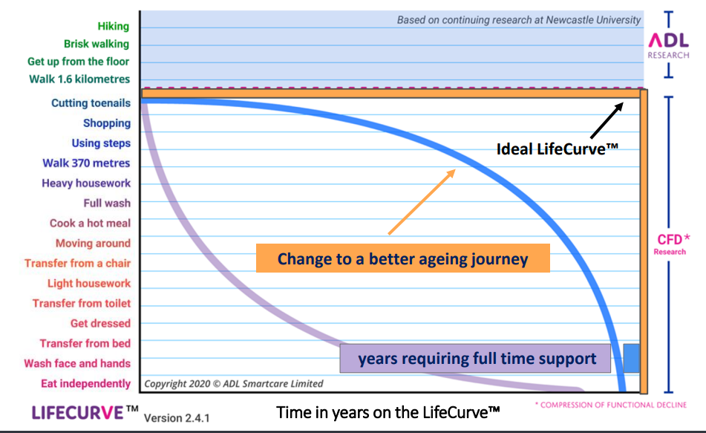

ADL Smart Care’s Life Curve
https://bayofplenty.lifecurve.co.nz/
https://www.adlsmartcare.com/

Slide 17
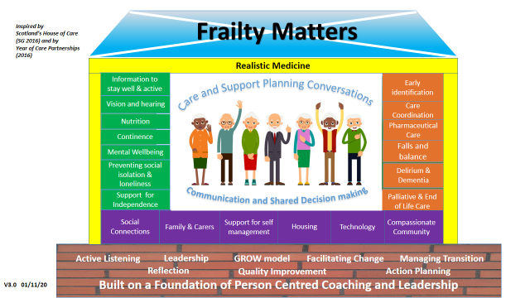
Frailty is everyone’s business
Community Nurses are well placed to identify frailty
Can initiate prompts and early intervention to prevent further functional decline
Currently adopt different approaches from assessment to their own intuition – further dedicated education is required
Care coordination requires leadership skills, confidence and capability.
British Journal of Community Nursing 2021 Vol 26, No 3 pp 136-142 https://www.magonlinelibrary.com/doi/abs/10.12968/bjcn.2021.26.3.136
https://www.alliance-scotland.org.uk/people-and-networks/frailty-matters-research-project/
British Journal of Community Nursing 2023 28:7, 324-330 https://www.magonlinelibrary.com/doi/abs/10.12968/bjcn.2023.28.7.324

Slide 18
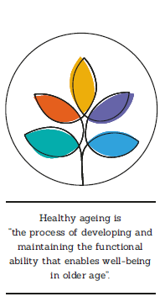
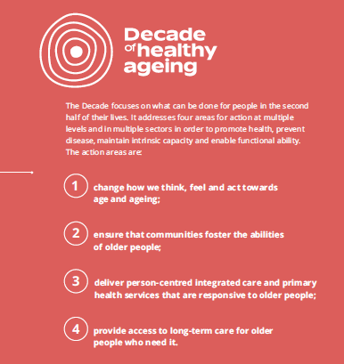
Beyond Functional Ability to Wellbeing
WHO describes 5 Domains of Functional ability
meet basic needs to ensure an adequate standard of living
learn, grow and make decisions
be mobile and participate
build and maintain relationships
contribute to society
Changing how we think, feel and act towards age and ageing
Ensuring our communities foster the abilities of older people
Delivering integrated health and care services responsive to older people
Providing access to long-term care for older people who need it
https://www.decadeofhealthyageing.org

Slide 19
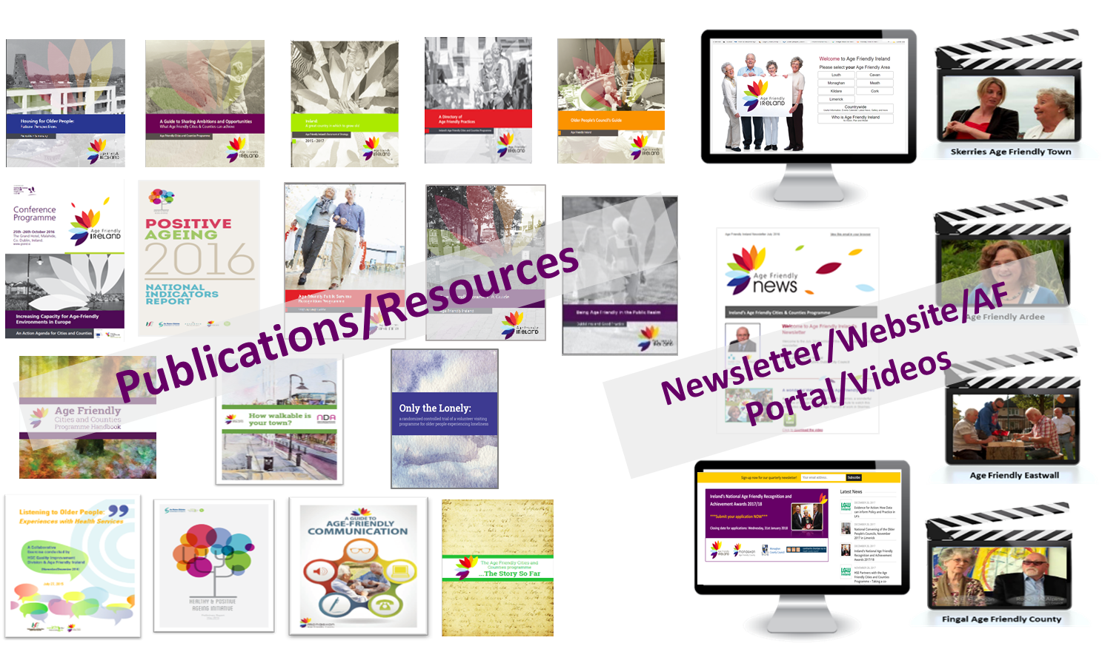
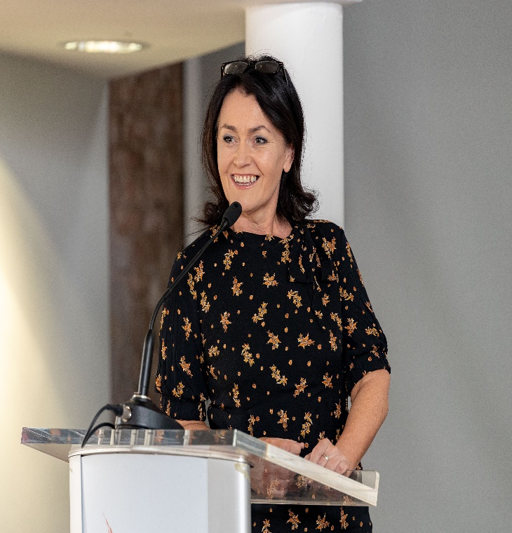
Resources | agefriendlyireland.ie
https://vimeo.com/453672155
Notes:
New Communication Strategy
Launch of Shared Service with WHO 16th Dec
Launch of airport guidelines

Slide 20
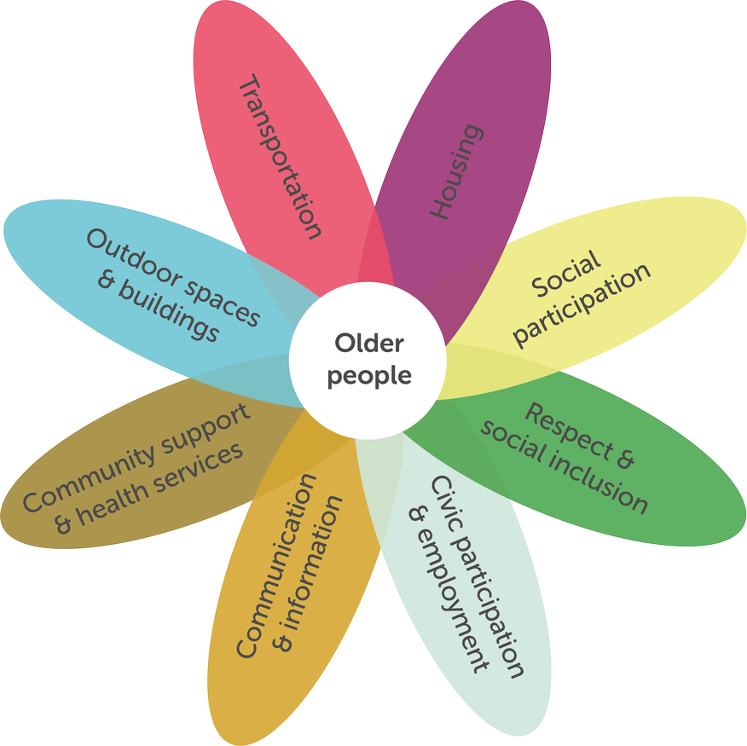
Centre for Ageing Better

Slide 21

Wellbeing in Later Life Project
WeLL Discovery Project October 2021 – April 2022
To enable local and national groups and communities to connect and collaborate on actions that create wellbeing in later life
To expand our movement to create age friendly, compassionate communities in Scotland
6 Conversation Cafes; 3 Co-lab events; 2 International Webinars
71 organisations / communities across Scotland participated

Slide 22
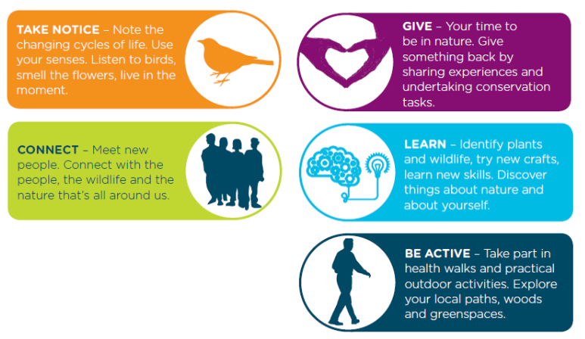
How do you enable Wellbeing?
New Economics Foundation’s 2008 report for Foresight’s Mental Capital and Wellbeing:
^{Five Ways to Mental Wellbeing.}

Slide 23



Co-Lab Sessions | Conversation Cafes | Café Themes
Co-Lab 1: 26 October 2021 | November 18 | Connect
Webinar: 15 December 2021 | December 9 | Keep Active and Eat Well
Co-Lab 2: 25 January 2022 | January 12 | Take Notice
 | February 16 | Give
Co-Lab 3: 30 March 2022 | March 16 | Keep Learning
Webinar: 27 April 2022 | April 14 | Reflections
WeLL Co-Lab report and flash reports are available at:
https://integratedcarefoundation.org/ific_hub/ific-scotland-programmes

Slide 24
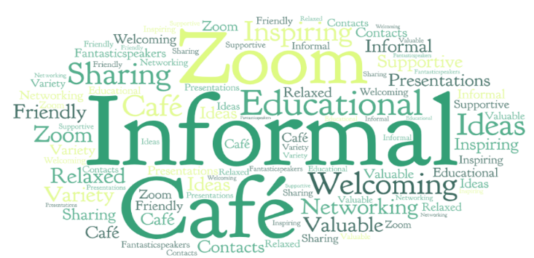

Having the opportunity to learn from different networks, organisations and services. Being part of a programme and learning network that will help us to share and grow our opportunities to make our local and city-wide communities inclusive and dementia friendly
Potential to herald resources, build connections and raise the profile of the range of work.
Can we align disparate projects so that we are not duplicating? – let’s not be precious!
This has been the most amazing opportunity and it’s always absolutely inspirational listening to the speakers the ideas, the best practice that can be shared, replicated and help to improve lives which is what this is all about for us.
This is not always about money – it’s supporting communities to do it themselves.
Christie in Action!

Slide 25
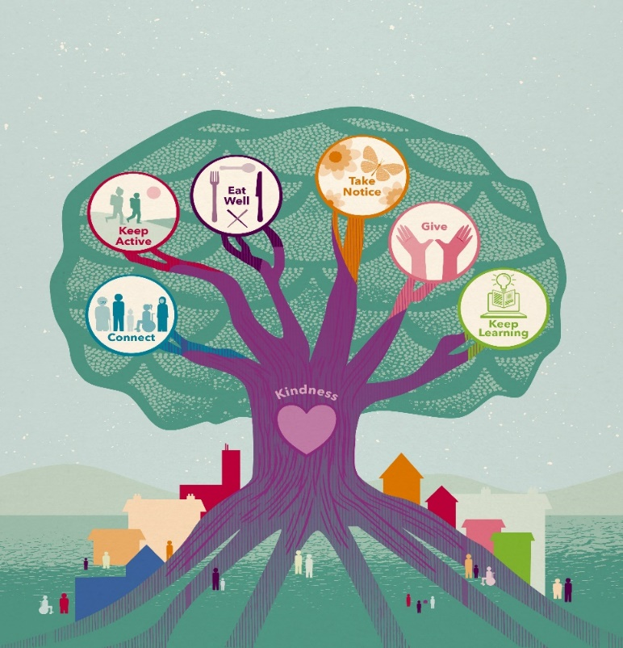
The Six Ways to Wellbeing are
mutually reinforcing
supported by strong roots of kindness
embedded within age friendly, inclusive, compassionate neighbourhoods

Slide 26

The ALLIANCE - Self Management, Aliss and Discover Digital programmes.
SOPA - new Age Friendly Communities Pilot programme for 12 months.
Age Scotland - new Health and Wellbeing Expert Friends Panel to develop and test interventions to motivate and support older adults to enjoy healthy active lifestyles.
Public Health Scotland and the Improvement Service - Shaping Places for Wellbeing programme across all life stages - creating better places to grow, live, work, play and age well.
The Care Inspectorate - new Care about Physical Activity: Supporting People’s Wellbeing programme
Paths for All has announced new funding to develop community path projects.
Network building and information sharing is key to ensuring that work is complementary and we can build momentum towards shared goals.

Slide 27
Recommendations
#1 To ensure coherence and optimal public value, and to achieve traction in implementing the forthcoming Scottish Government Health and Social Care Strategy for Older People, we need to align our collective efforts and join up these national initiatives.
#2 We believe Scotland needs a cross sector national network that engages all 31 community planning partnerships in creating Inclusive, Compassionate Age Friendly Communities that enable Wellbeing in Later Life. This national network needs strategic leadership and dedicated support for facilitation.
#3 The national network should involve academic partners to exploit opportunities for innovation, research and evaluation through future UKRI funding calls.
#4 Scotland should continue to seek international collaborations on healthy ageing and with the UK and Global Networks of Age Friendly Communities.

Slide 28

Make every conversation, consultation and contact count to create wellbeing!

Slide 29
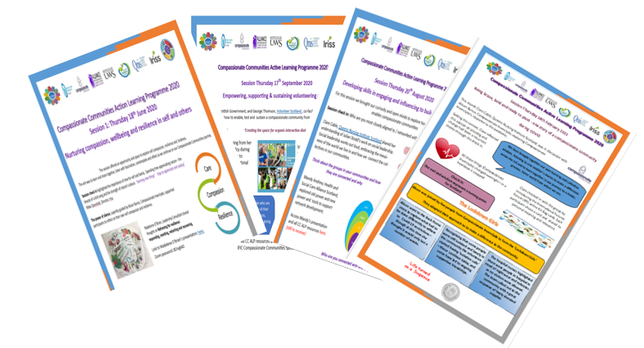
https://integratedcarefoundation.org/ific_hub/ific-scotland-programmes

