Slide 1
Upstream approaches to prevent frailty and/or falls
Dawn Skelton
Professor of Ageing and Health: Glasgow Caledonian University
Director: Later Life Training

Slide 2
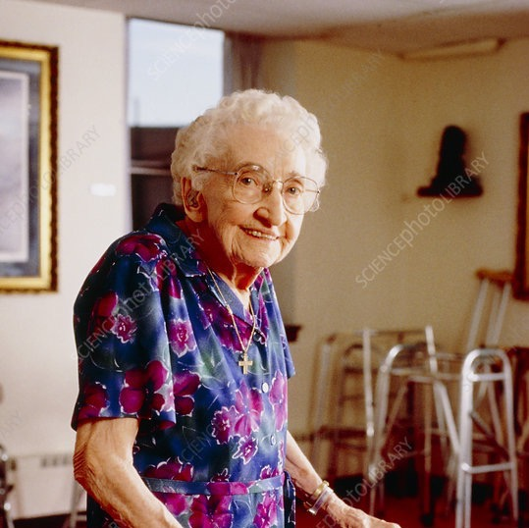
What I will cover:
Falls and frailty
Risk factors for falls and frailty
Effect of Covid-19 social restrictions
Preventing frailty or that first injurious fall
Right programme, right person, right time - difference between a strength and balance programme and effective falls prevention
Delivering the right messages and knowing scope of practice
@GCUReach @LaterLifeTrain

Slide 3
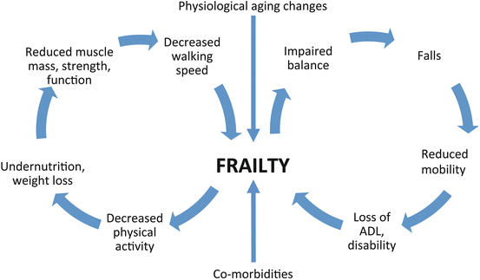

Slide 4
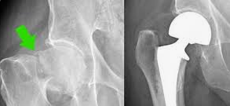
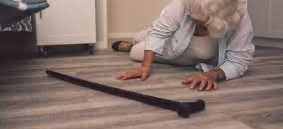
Falls: The stats
1 in 5 over 50 report recurrent falls
2 in 5 over 75 report recurrent falls
In care homes, 4 in 5 had multiple falls in past 6 months
6 people over 80 fall every minute in the UK
Ambulance call outs to fallers costs £350 million per year
50% hospital admissions for injury due to a fall
Tilda Report 2017, Taking Care 2023, Skelton & Todd WHO report 2005; Care Inspectorate 2016
@GCUReach @LaterLifeTrain
Notes:
ON LEFT
Image of bone structure on left healthy bone (woman in her 30s) on right osteoporotic bone (woman in her 70s)
Graph show rise of fractures of vertebra, distal forearm and hip by age and gender. Note increase of fractures with age.
WHO projections show a veritable epidemic of hip fractures by 2050 if we don’t do something about it.
But bone strength only part of the issue in fractures
The European Prospective Osteoporosis Study demonstrated that low bone mineral density is less predictive than risk of falling for future limb fractures in women across Europe and that falls explain between centre differences in the incidence of limb fracture across Europe
Roy DK, Pye SR, Lunt M, O’Neill TW, Todd C, Raspe H, Reeve J, Silman AJ and the European Prospective Osteoporosis Study (EPOS) Group. Falls explain between-center differences in the incidence of limb fracture across Europe. Journal of Bone and Mineral Research. 2002. 31(6) 712-717.
Kaptoge S, Benevolenskaya LI, Bhalla AK, Cannata JB, Boonen S, Falch JA, Felsenburg D, Finn JD, Nuti R, Hoszowski K, Lorenc R, Miazgowski T, Jajic I, Lyritis G, Masaryk P, Naves-Diaz M, Poor G, Reid DM, Scheidt-Nave C, Stepan JJ, Todd CJ, Weber K, Woolf AD, Roy DK, Lunt M, Pye SR, O’Neill TW, Silman AJ, Reeve J. Low BMD is less predictive than risk of falling for future limb fractures in women across Europe: Results from the European Prospective Osteoporosis Study (EPOS). Bone. 2005. 36(3) 387-398.
So fall prevention worth doing
ON RIGHT
Basic epidemiology of falls (Talk them through the numbers)

Slide 5
Preventing frailty and that fall that leads to activity avoidance
What can you do to support older people to age successfully?

Slide 6
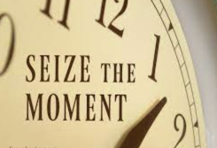
Intervening early …. Primary prevention
Falls don’t just start at 65
Time points when we could change the trajectory
Transition points where PA can drop suddenly (and losses of strength and balance could lead to avoidance of other activity)
Importance of mapping provision (choice/needs/availability/opportunity)
Right person, right time, right programme, right deliverer
We all need to ASK
Falls / PA / avoidance of PA
We all need to deliver the right messages
What is strength/balance? What isn’t! What are the guidelines?
We all need to understand who needs what and when!
Support behaviour change – COM-B

Slide 7
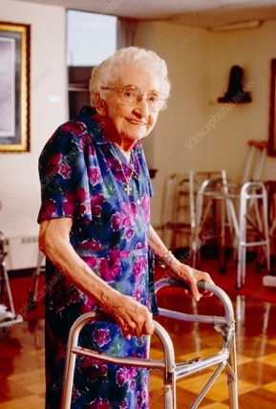
Risk factors for falls (+frailty)
The most common (from systematic reviews):
Previous history of a fall
Advanced age
Poor gait
Poor balance
Poor functional ability
Poor strength
Fear of falling and low balance confidence
deconditioning, changed movement patterns, poor reactions and speed of movement, forward flexed posture, variable cadence …..
modifiable with exercise + posture, postural hypotension, continence, mood, proprioceptive feedback and kinesthetic awareness
“It’s the fear that restricts me. In my mind I know that I can’t [walk outside]. The fear of falling and not having the strength to go out, that stops me from going out…”
(Female, 60yrs)
Deandrea S. Epidemiology 2010
@LaterLifeTrain @GCUReaCH

Slide 8
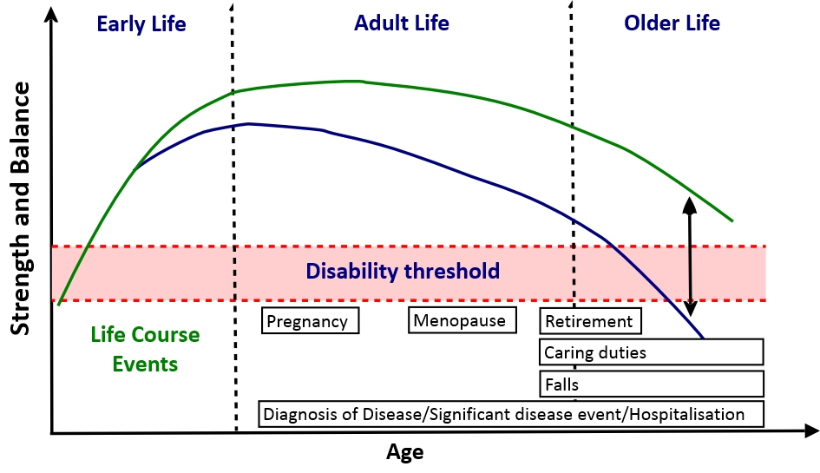
Social Care
Social Prescribers
Mental Health Services
Smoking Cessation Services
Ophthalmic Services
Continence Services
Exercise Instructors
Volunteers
Consultants
Nurses
Physiotherapists
Occupational Therapists
Podiatrists
Fracture Clinics
Frailty Services
General Practitioners
Skelton et al. JFSF 2018

Slide 9
We all need to ASK
Falls / PA / avoidance of PA

Slide 10
PA participation drops and reserves of fitness are lost
< 25%
< 15%
Strain et al. BMC Public Health 2016

Slide 11
Physical Activity at 65 predicts falls at 90
Cohort of 1596 retirement community residents
Current age = mean 94 years
Self reported PA in 1980s, self reported falls now
52% fallers, 32% recurrent fallers
Risk of falls and recurrent falls 35-40% lower in those reporting 30+ minutes of moderate intensity physical activity per day compared to those doing less
PHYSICAL ACTIVITY =
PRIMARY PREVENTION
Paganini-Hill et al. Age Ageing 2017

Slide 12
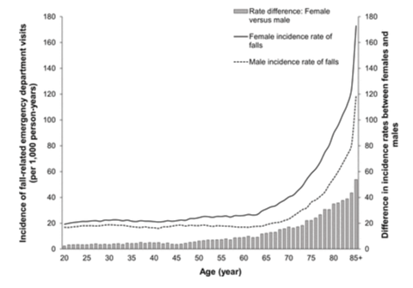
2019
state-wide North Carolina emergency department visit data
incidence rates of fall-related emergency department visits began to increase in early middle age, particularly for women

Slide 13
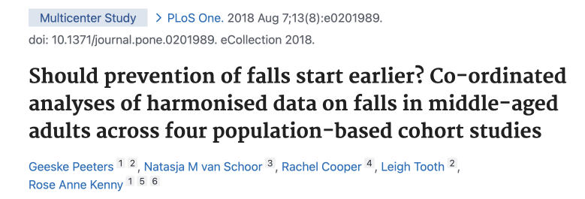
Prevalence of falls age 40-64
Data from 4 population-based cohort studies (Australia, Ireland, Netherlands, UK; n=19,207)
Women
8.7% in 40-44yrs to 29.9%yrs in 60-64yrs
Men
14.7% in 45-49yrs to 15.7% in 60-64yrs
Middle-age may be a critical life stage for preventive interventions

Slide 14
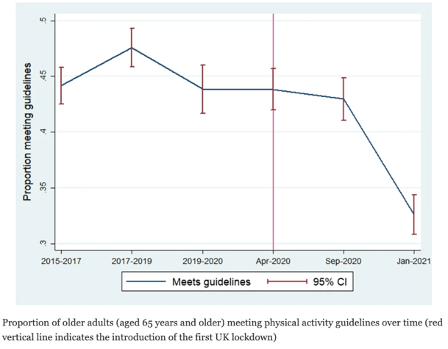
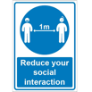
Effect of pandemic on activity behaviour
March 2020 ‘Stay at home order’ issued by Governments
Ongoing social restrictions for >18 months
Activity restriction (particularly incidental and leisure activity)
Deconditioning
Increased frailty (reduced access to rehab)
Rehabilitation pandemic
43% to 33% irrespective of health condition, age, deprivation or pre-pandemic activity levels
sedentary behaviour
Elliot et al. BMC Public Health 2022
De Biase, Cook, Skelton, Witham, Ten Hove. Age Ageing 2020; Public Health England, Covid impact on falls, 2021; Christensen et al. PLOS One 2022; Hoffman et al. JAGS 2022
@GCUReach @LaterLifeTrain

Slide 15
Covid-19 and impact on falls
Modelling on the ↓strength and balance activity in first lockdown (3 months) period in England predicted >250,000 more falls in 110,000 people, costing £211 million over next 2.5 years
In those who had Covid-19
2.3x more likely to have trouble getting out of a chair
2x more likely to have reduced both household and recreational activity
Many community activities, clubs etc. are more poorly attended now and less
older volunteers
Did you notice a change in your older participants after restrictions eased?
Dunstan et al. Nature Reviews 2021
PHE, 2021. https://bit.ly/36nGGbL)
@GCUReach @LaterLifeTrain

Slide 16
We all need to deliver the right messages
What is strength/balance?
What isn’t!
What are the guidelines?

Slide 17
Not all physical activity improve strength & balance?
Not all physical activity impacts on the right components of fitness
Many work on strength and balance
Not all have evidence of effect
UK Chief Medical Officers' Physical Activity Guidelines 2019; Foster et al, JFSF, 2019; Skelton & Mavroeidi, JFSF 2019

Slide 18
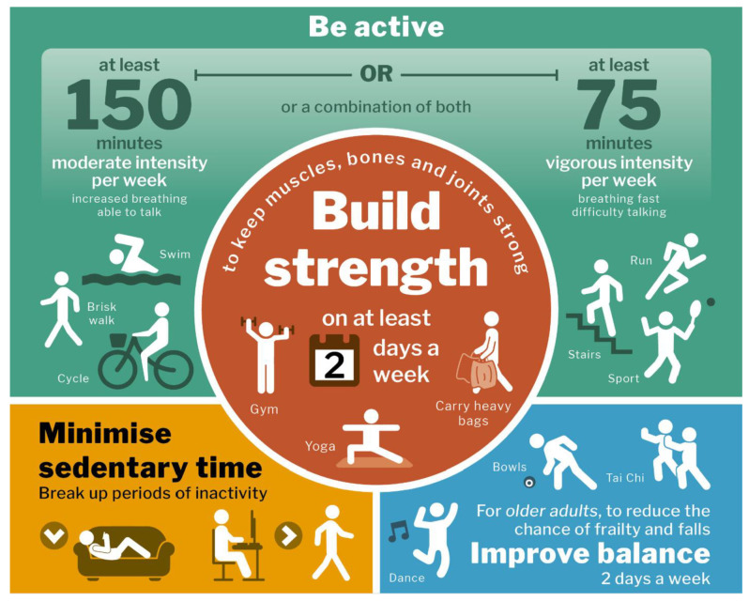
What are strengthening activities?
A lot of people just go for a walk and don’t do anything else
walking, yoga and pilates most commonly quoted for strengthening activities
Messaging and Communication should be based on evidence
Physical Activity Messaging Framework (PAMF) and Checklist (PAMC)
Gluchowski et al. IJERPH 2022; Williamson C et al. IJBNPA 2021

Slide 19
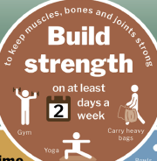
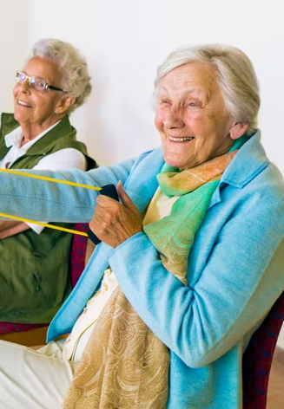
What is ‘strengthening’ activity?
SPECIFICITY: responses to exercise training are specific to the stimulus induced by the exercise task
OVERLOAD: A greater than habitual stress or load on the body is needed to induce adaptation
PROGRESSION: A gradual and systematic increase in stress placed on the body is necessary to induce continual training adaptation over a period of time
You need to feel the muscles warm, tense, even shaky to know you are having a training response on those muscles
10 reps won’t do it!
EFFECTS STOP WHEN DISCONTINUE
@LaterLifeTrain @GCUReaCH
Notes:
These are FUNDAMENTAL considerations for effective exercise prescription.
Might be worth turning Specificity, Overload and progression into a table just to make it visually different.

Slide 20
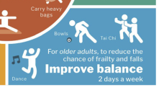
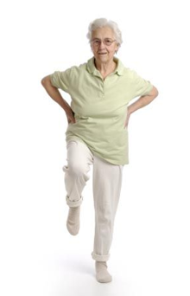
What is ‘balance-challenging’ activity?
Reduced Base of Support (BOS)
Moving Centre of Mass (COM)
Reduced arm support
Functional stability limits
Dynamic stability
Anticipatory control
Reactive control
You need to feel wobbly for the nervous system to practice and train
Integrating information from muscles, eyes, vestibular system, joints and then moving the body in the right way to keep you upright
EFFECTS STOP WHEN DISCONTINUE
@LaterLifeTrain @GCUReaCH
Sherrington et al. 2017; Sibley et al. 2015, 2021

Slide 21
Communicating for success
Guideline Health and other benefits | Professional interpretation Detailed understanding | Translation for the public education and meaning
Undertake strength and balance activities at least twice a week Strength activities also help immune function, body temperature control, bone health, brain health, manage blood sugars Balance activities help with feeling stable and confident, help brain health and maintain independence | Meaning of strength, resistance, overload, (not just sets/reps) activity modes, rest and recovery. Balance challenge means reduced base of support, turning, sudden changes of direction, compensatory stepping, reactive. | Positive framing, modifying technical language, contextualized, tailored Explaining, not dumbing down or patronizing but accessible Muscles feel warm, may shake, may feel the next day, tension Feeling wobbly, regular practice to coordinate all the senses and muscles to keep us upright
Williamson C et al. IJBNPA 2021

Slide 22
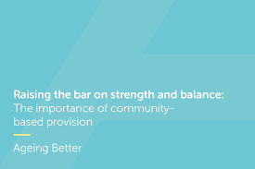
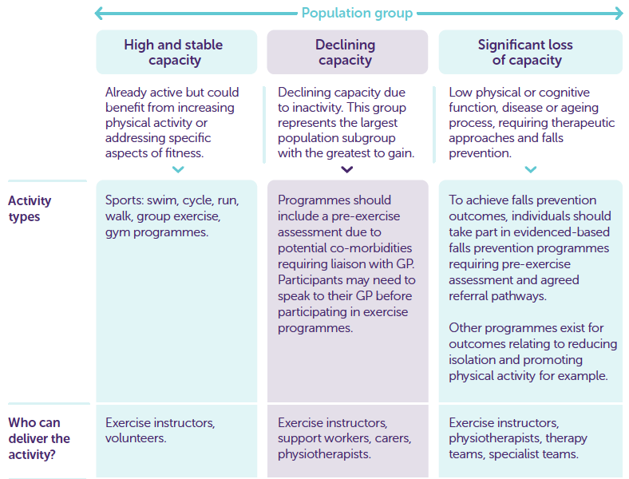
Centre for Ageing Better, Raising the Bar, 2019
@LaterLifeTrain @GCUReaCH

Slide 23
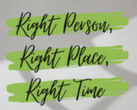
We all need to understand who needs what and when!
Support behaviour change – COM-B

Slide 24
Are they ageing successfully?
Self-assessment of function and physical activity
Discussion about capability, opportunity and motivation to be more active
Local opportunities to improve components of fitness below ‘par’
What’s normal for 30s chair rise?
What’s normal for one leg stand?
@LaterLifeTrain @GCUReaCH
De Jong LD, et al. Clin Interv Aging: 2018
www.laterlifetraining.co.uk

Slide 25
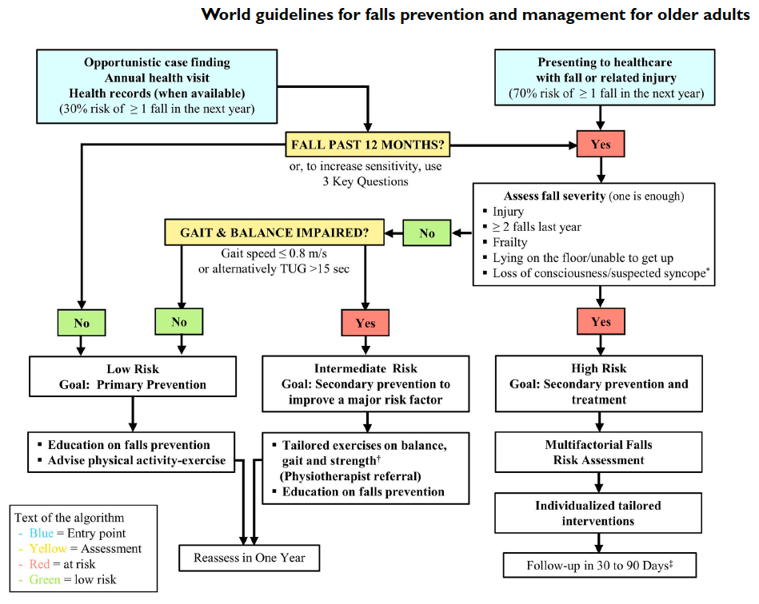
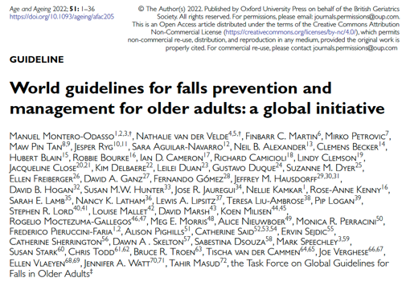
NO STATEMENTS ON AGE ONLY ON ‘RISK’
Accompanying injury
Multiple falls (≥2 falls) in last yr
Known frailty
Inability to get up after the fall without help
Accompanied by (suspected) transient loss of consciousness
Montero-Odasso et al. Age Ageing 2022
Notes:
DS – I won’t spend much time at all on these, more just raising awareness they exist. This slide I will just say the algorithm includes referral to falls prevention exercise if gait speed lower than 0.8m/s and /ot TUG >15 secs IRRESPECTIVE OF WHETHER THEY ARE FALLERS/FEARFUL etc!! So exercise referral should be the cornerstone of MDT Treatment

Slide 26
FINDING THE FALLERS – CATCHING THEM EARLY?
Physios
Social Care
Nurses
…….
Exercise Instructors
Social Prescribers
Clinicians should routinely ask about falls in their interactions with older adults
Ask
Have they experienced one or more falls in last 12 months?
About the frequency, characteristics, context, severity and consequences of any falls
If they have experienced dizziness, loss of consciousness or any disturbance of gait and balance
If they experience any concerns about falling causing limitation of usual activities
If they say yes to any of these, offer a gait and balance assessment (gait speed and TUG) for differentiating intermediate and high risk from low risk
Do you do regular physical activity to maintain your health or fitness?
Do you avoid any physical activities or have stopped any physical activities recently??
Montero-Odasso et al. Age Ageing 2022

Slide 27
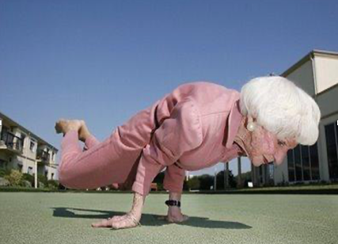
FALLS RISK STRATIFICATION – who/what/where
Older adults at low risk for falls
Should be offered education about falls prevention and exercise for general health and/or fall prevention if interested
Reinforce physical activity (aim to meet PA Guidelines), lifestyle habits and nutrition (incl. Vit D)
Referral to local community health promotion or ‘ageing well’ programmes
Older adults at intermediate risk for falls
Should be offered targeted exercise or a physiotherapist referral in order to improve balance and muscle strength, and reduce their fall risk
Older adults at high risk for falls
Should be offered a multifactorial falls risk assessment to inform individualised tailored evidence-based interventions to reduce falls
Montero-Odasso et al. Age Ageing 2022

Slide 28
CONSIDER HIGH RISK AND OFFER EFFECTIVE INTERVENTIONS
Accompanying injury
Multiple falls (≥2 falls) in last yr
Known frailty (CFS 4 or more)
Inability to get up after the fall without help
Accompanied by (suspected) transient loss of consciousness
@GCUReach @LaterLifeTrain
Montero-Odasso et al. Age Ageing 2022
Notes:
DS – I won’t spend much time at all on these, more just raising awareness they exist. This slide I will just say the algorithm includes referral to falls prevention exercise if gait speed lower than 0.8m/s and /ot TUG >15 secs IRRESPECTIVE OF WHETHER THEY ARE FALLERS/FEARFUL etc!! So exercise referral should be the cornerstone of MDT Treatment

Slide 29
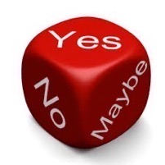
The devil is in the detail
Not all Strength & Balance programmes reduce falls!
Sherrington et al. Cochrane Review 2019

Slide 30
KNOWN EFFECTIVE PROGRAMMES
Otago (OEP Leader) – Strength & Balance | FaME (PSI) - Multicomponent
Warm up – 5 mobility exercises | Warm up – Circulation boost and mobility
 | Endurance – aerobic Interval training incl. balance challenge, step variability
Balance – 12 exercises – static & dynamic | Balance – static & dynamic, propulsive, reactive
Strength – 5 exercises all lower body, 3 with ankle weights | Strength –all major muscle groups, using body weight, bands, free weights
Walking programme | Getting up from/down to the floor & floor coping strategies
 | Stretches for ROM & Adapted Tai Chi
Most effective >80s high risk | Effective >65s, low risk/sedentary & high risk

Slide 31
FaME – backed up by service evaluations
Steady Steps Programme, Edinburgh (FaME/PSI)
24 weeks
‘Staying Steady’ classes, Gateshead (FaME/PSI)
20 weeks
For every £1 of public health money invested in Staying Steady classes, the return to the public purse is £50.59
@LaterLifeTrain @GCUReaCH
http://www.gatesheadopa.org.uk/news/sroi/
Hedley et al. Physio Theory Practice 2010

Slide 32
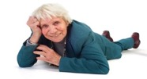
When reduced falls is the outcome….
You wouldn’t give a cancer patient only half the dose of chemotherapy…..
Or give them a different drug that was not known to work…..
Treat falls prevention ‘treatment’ like any other effective rehabilitation pathway
Effective programme for outcome
Effective dose / regularity
Effects discontinue if stop
Specialist exercise instructors/ physiotherapists
Sherrington C et al. Cochrane Database of Systematic Reviews 2019, plus update for Global Falls Guidelines 2021
@LaterLifeTrain @GCUReaCH

Slide 33
REMEMBER!
Increasing strength & balance activity by 60 minutes per week in an older population ↓ rate of falls by 6.0%
An effective falls prevention programme (2 hours per week) leads to far greater reductions in falls of between 26-54% AND increases habitual physical activity
PHE, Wider impacts of Covid-19, 2021; Skelton Age Ageing 2005; Iliffe BJGP 2015; Orton Age Ageing 2021
@LaterLifeTrain @GCUReaCH

Slide 34
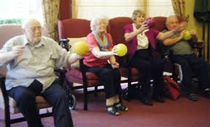
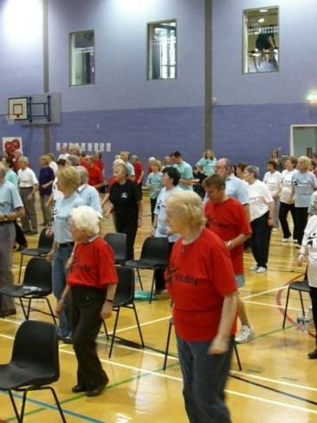
Misunderstandings and myths?
Chair based exercise does not reduce falls
Gentle exercise won’t challenge someone’s nervous and muscular system enough to lead to physiological and neurological change
Something is not better than nothing when there is something that works and works well
Improving strength and balance might reduce risk factors for falls but does not mean you will reduce falls
Doing a couple of Otago exercises 10x once a week won’t reduce falls
Big groups = less effective / no individualisation
@LaterLifeTrain @GCUReaCH

Slide 35
Covid-19 wider impacts: Key Recommendations
For the whole population
For targeted populations:
Promote and increase availability of strength and balance activity for older adults, involving a gradual increase in activity in order to reduce falls risk and to enable safe and confident participation on other forms of exercise and physical activity
Ensure physical activity recovery measures reach those who stand to benefit most from them, including older adults who shielded, with multimorbidity, with dementia, in social care settings and from more deprived backgrounds
Identify locally which older adults have reduced their levels of physical activity during the COVID-19 pandemic, with a focus on populations where the largest reductions are likely to be found. >65s
Refer older adults with functional loss, transition towards frailty or fear of falls resulting from deconditioning to appropriate rehabilitations services
Raise awareness amongst health and social care staff of post-COVID-19 syndrome, communicating the risks of building up levels of activity levels too rapidly and the need to refer to post-COVID-19 syndrome clinics where symptoms are severe
(PHE, 2021. https://bit.ly/36nGGbL)

Slide 36
Key messages
Meeting PA guidelines (Aero+Str+Bal) prevents someone becoming a faller later in life
Not all PA improves strength and balance
Most people (and many HCPs) don’t know what activities improve strength and balance
Work on appropriate messaging
Need a better ‘offer’ / choice of relevant activities
Bust those myths
Its NOT possible to improve balance with chair-based exercise
Improving strength needs more than ‘gentle’ / body weight
Not all S & B reduces falls (even if it improves strength and balance!)
Right programme, right person, right time
TREATMENT = evidence based / dose sufficient / targeted / individualised
Treat falls prevention with same respect as chemotherapy or CVD/stroke prevention

Slide 38
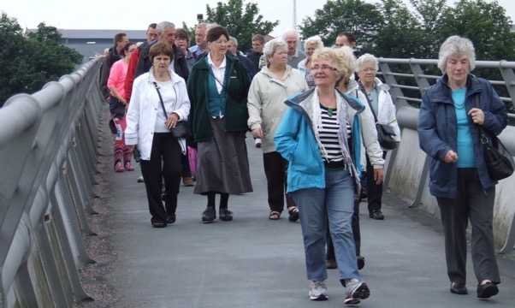
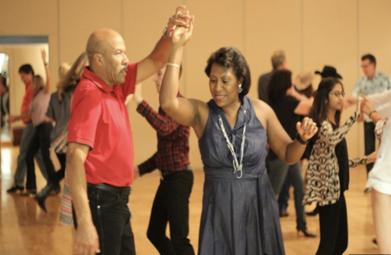
Walking
DANCE
Most common activity done & recommended
Uncertain effects on strength or balance
No effects on falls rates – may increase risk of falls
Not for TREATMENT in high-risk fallers
Can reduce risk factors (balance/gait/strength)
Depending on the style of dance. No effects on falls rates.
Not for TREATMENT in high-risk fallers
Voukelatos et al. Age Ageing 2015; Bai et al. Front. Public Health 2022; Sherrington et al. Cochrane Review 2019.
Ararat-García et al. Gac Med Mex. 2022; Sherrington et al. Cochrane Rev 2019; Montero-Odasso et al. 2022; OPF-PRU Report 2023
@LaterLifeTrain @GCUReaCH

Slide 39
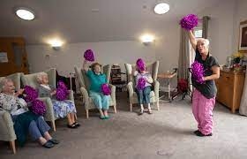
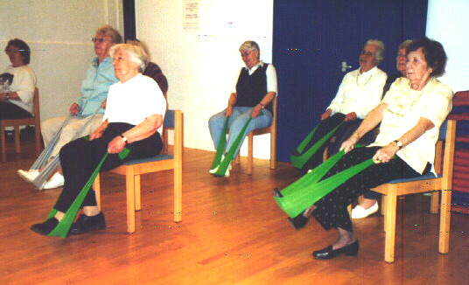
CHAIR BASED EXERCISE
STRENGTH TRAINING
Seated exercise does not challenge balance but may improve upper and lower limb strength.
No effect on falls rates
Not for TREATMENT in high-risk fallers
Improves upper and lower limb strength. Uncertain effects on balance.
No effects on falls rates
Not for TREATMENT in high-risk fallers
Sherrington et al. Cochrane Review 2019; Montero-Odasso et al. 2022
Sherrington et al. Cochrane Rev 2019; Montero-Odasso et al. 2022
@LaterLifeTrain @GCUReaCH

Slide 40
When should a strength and balance programme call itself a falls prevention programme?
When there is evidence from RCTs that it works
service evaluations of programmes are not robust and biased
When there is:
Baseline assessment from which to progress an individualised and tailored prescription
Noticeable different levels of challenge seen in the individuals in a group
Progression, introducing complexity and reducing support options and resistance over time
Education, behaviour change and motivational techniques supporting an understanding of fear of falling / avoidance of activity / benefits of exercise and specific components of fitness / importance of home based exercise / effects discontinue when stop
Delivered with fidelity to the known effective programme (RCT)
@LaterLifeTrain @GCUReaCH

Slide 41
Otago and FaME are not the same
Otago Exercise Programme
Pre-set programme 24 exercises (lower limb only)
5 mobility, 5 strength, 12 balance, 2 flexibility
Plus walking
Plus specific support schedule for home exercise
Is a standing programme (Otago can’t be seated!)
Suitability determined by physiotherapist
Specific population group to most benefit (not for all older people!)
OEP Leaders (Exercise Instructors)
Should hold minimum L2 Fitness Qualification
Need support/shouldn’t be working in isolation/follow guidance*
Should refer back if out of scope*
Training focus on group management skills
Training within NHS settings - one to one and behaviour change focus
@LaterLifeTrain @GCUReaCH

Slide 42
Otago and FaME are not the same
Postural Stability Instructor's (PSIs)
Should hold minimum L3 Fitness Qualification
Best to work in partnership but can work in isolation*
Should refer back if out of scope*
Training focus on group management skills, tailoring, assessment, progressions and working with wide range of capability from primary to secondary prevention
Seated skilling-up may be required
Many PSIs hold also hold other specialist exercise qualifications and may also be Otago Leaders
FaME
7 evidence-based activities/multicomponent
Includes getting up from floor skills
Designed as a group programme
Includes need for home exercise to achieve dose
Evidenced to increased PA minutes as well as reduce risk and rate of falls
FaME could be appropriate for wide range of older people - and all exercises progressed ++
No ceiling affect like Otago Exercise Programme
Otago exercises form part of the exercise base (particularly the home based prescription)
@LaterLifeTrain @GCUReaCH

Slide 43
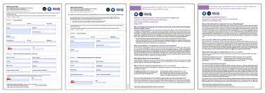
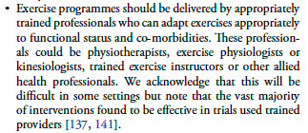
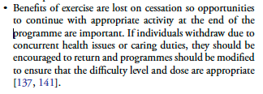
Appropriately trained professionals
https://agile.csp.org.uk/content/referrals
A standardised ‘Referral Form’ for transfer of assessment and treatment information from the physiotherapist to the exercise professionals trained in Otago or FaME
- To continue to build on their exercise journey for better gains
Sherrington C et al. Cochrane Database of Systematic Reviews 2019, plus update for Global Falls Guidelines 2021; Montero-Odasso et al. Age Ageing 2022
@LaterLifeTrain @GCUReaCH
Notes:
Seated exercise programs run by volunteers trained for a few hours in a few exercises will NOT be able to adapt, tailor or progress exercise 0 importance of suitably trained ex professionals in the pathway – and revolving door – if they don’t get enough dose with therapy they will end up back there very soon!

Slide 44
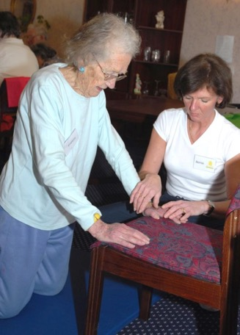
Best practice - Therapy to Community Exercise Provision
Pathway specifically to aid transition on for effective dose requirements
63% of people transitioned on to FaME sessions
Reduced hospitalisations and injuries
Needs to be BOTH WAYS
Finding the fallers who are in GENERIC exercise provision
Stop the transition into frailty by people leaving sessions because….
Therapy led rehabilitation
NHS – 12 weeks
Referral from GP
Not eligible for rehabilitation but could benefit from S & B programme
Otago program
Community OEP Leader
12 weeks
FaME program (Active Always)
Community PSI led
Ongoing
Other S & B programs / Tai Chi
(NOT seated/gentle)
#LLTOEP
Hawley Hague, Physio Theory Practice 2017

Slide 45
PRIMARY AND SECONDARY PREVENTION IN ONE PATHWAY
Falls Assessment
Identification of a falls problem and screening to determine risk factors *
Motivation Pathway
Secondary Prevention
Therapy led (based on Otago/FaME)
Self-referral
Chair Based Exercise Class
(Community based)
OTAGO
Group programme
(Community based)
FaME group programmes (Community based)
Exercise Referral Scheme
Ask:
Are these the right sessions for people?
Falls history / concern about balance
Community based classes for older people
Primary Prevention
Tai Chi / Dance / Pilates / Yoga / Gym / Circuits / Nordic Walking / Walking Sports / Walking Groups + S&B
Notes:
Added in assessment box: * undertaken by an appropriate person
AGREE but changed font so can see easier ;)

