Slide 1
How can South Ayrshire support ageing well?
Doug Anthoney, Health and Wellbeing Manager

Slide 2
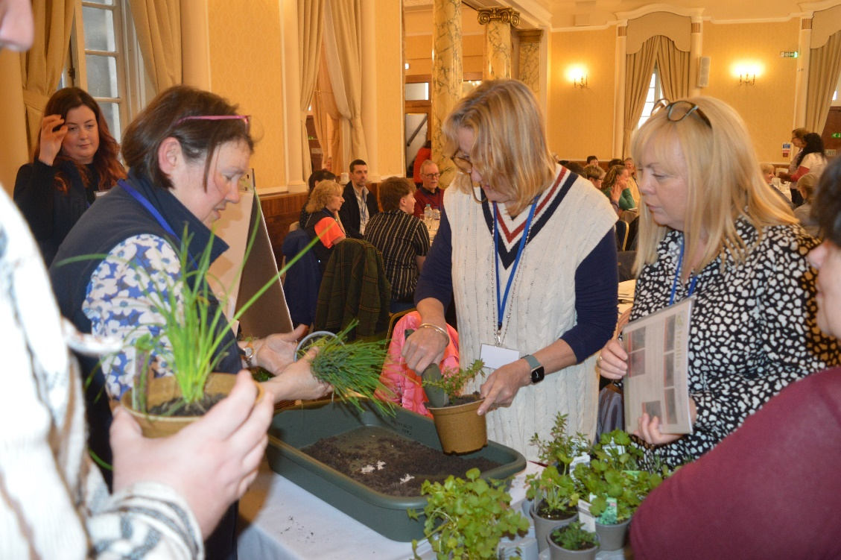
Introducing Age Scotland’s Health and Wellbeing team
Knowledge and networks

Slide 3
Introducing Age Scotland’s Health and Wellbeing team
Knowledge and networks
Health promotion

Slide 4
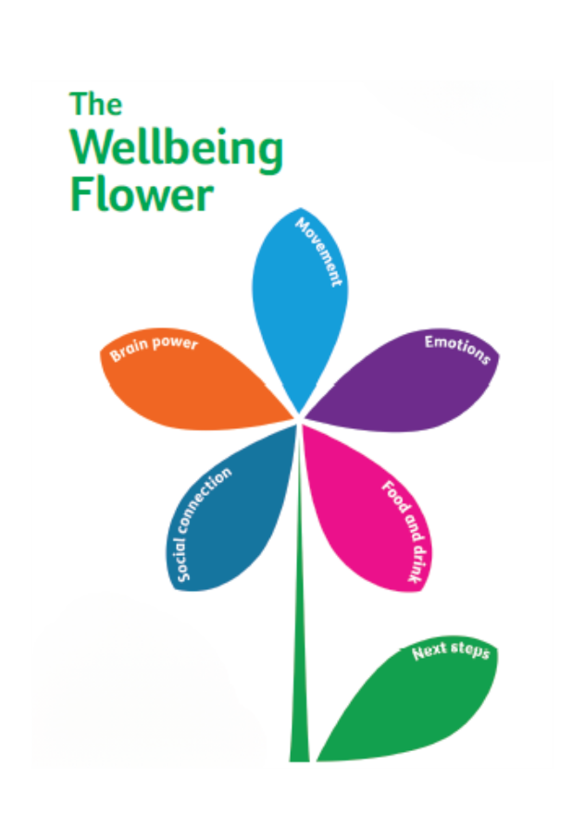
Introducing Age Scotland’s Health and Wellbeing team
Knowledge and networks
Health promotion
Resources

Slide 5
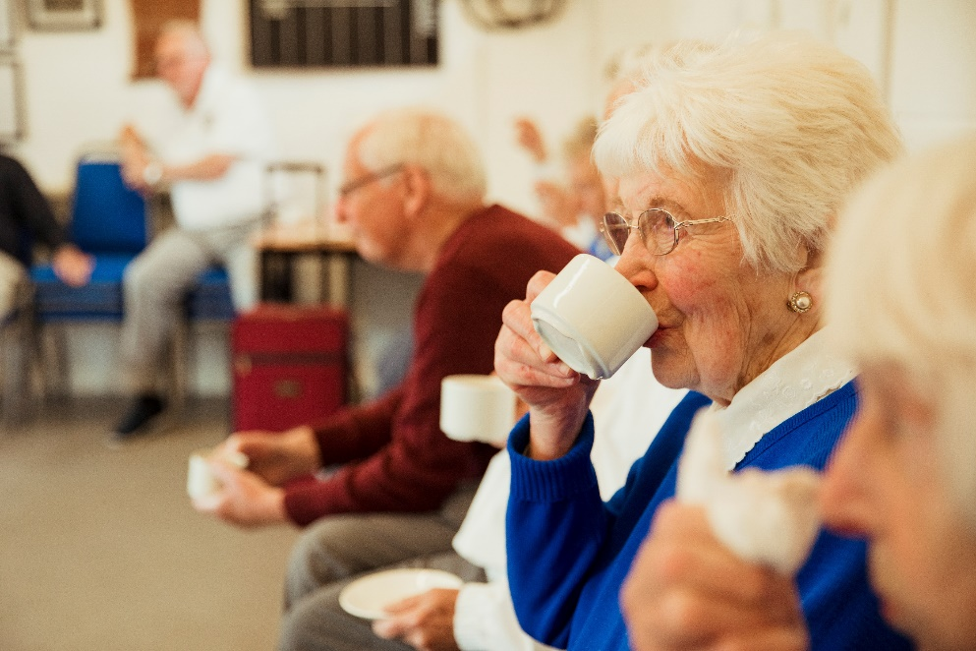
Embedded within Age Scotland

Slide 6
Age Friendly is a great start
Utilise peer support (and intergenerational)
Invest in community groups
Use empowering messaging
Emphasise wellbeing and meaning
Cultivate purpose and meaning

Slide 7
Utilise community groups and services

Slide 8
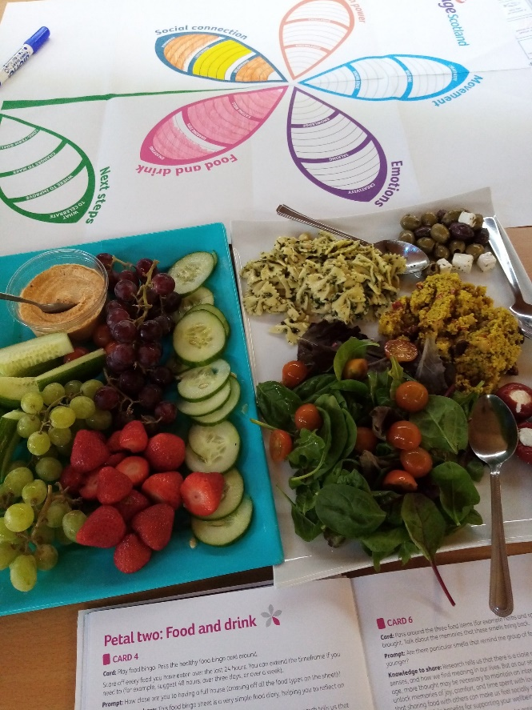
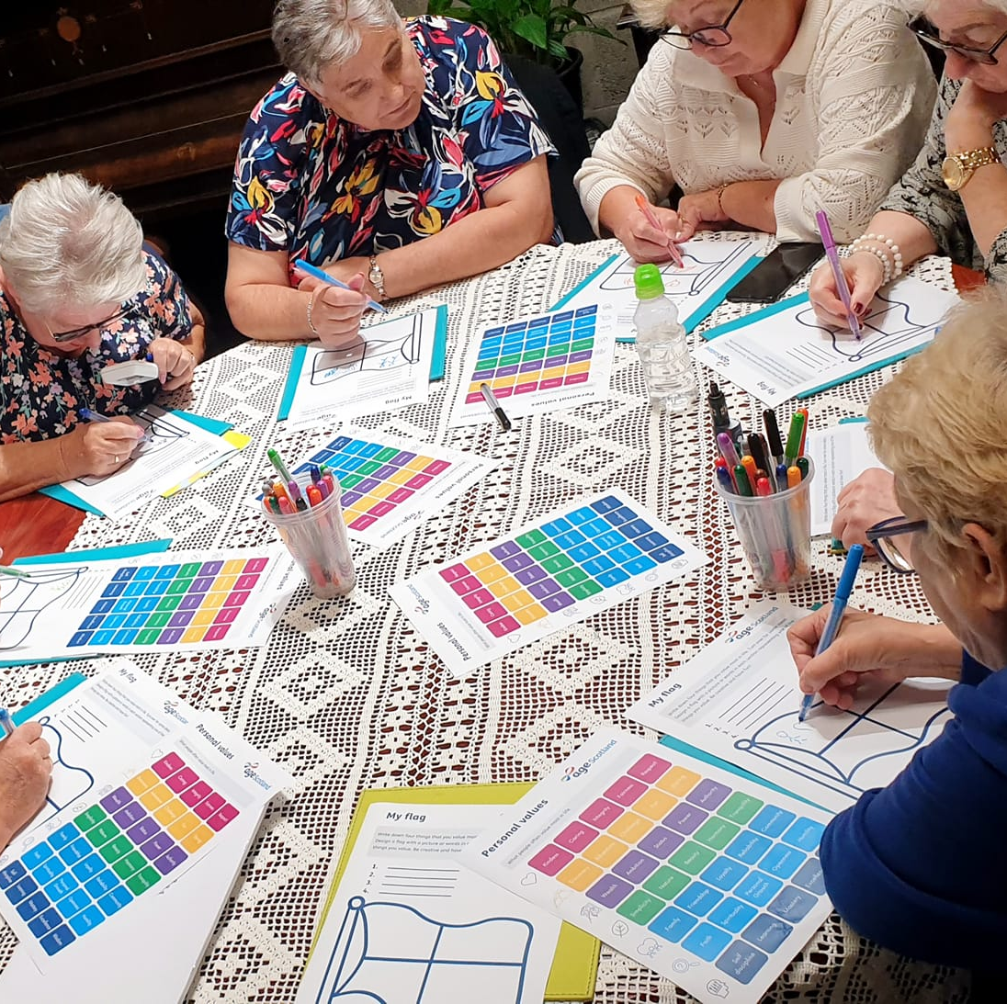
Utilise community groups and services

Slide 9
Emphasise wellbeing and meaning
Notes:
Meaning and purpose research links
Will a purpose-driven life help you live longer? - Harvard Health
Longevity: Having a purpose may help you live longer, healthier (medicalnewstoday.com)

Slide 10
Use empowering messaging
Develop with older people
Focus on wellbeing now – no guarantees
Fun, company and independence
Notes:
Meaning and purpose research links
Will a purpose-driven life help you live longer? - Harvard Health
Longevity: Having a purpose may help you live longer, healthier (medicalnewstoday.com)

Slide 11
Other ways Age Scotland can help
Resilience and energy workshops
Unforgotten Forces
Community Connecting
Community Development
Thematic forums
Age Friendly workplaces
Big Survey

Slide 12
Thanks for listening. Questions?
https://age.scot/resourcesforwellbeing
healthandwellbeing@agescotland.org.uk
0131 668 8054

