Slide 1
An asset-based approach to social care – our journey
Cath Roff
Programme Director:
Social Care Transformation

Slide 2
Content
Strengths-based social work
Asset-based Community Development
Commissioning – especially home care

Slide 3
Context
April 2015 started in Leeds as Director of Adult Social Care
Coincided with Care Act 2014 coming into being
What did a strengths-based approach in social care mean especially for social work?
What was it like to be a social worker in Leeds?

Slide 4
What did I find?
A strong city history of asset-based approaches
A council with an ambition to be “a compassionate city with a strong economy”
Social workers frustrated by “bureaucracy”
Onerous processes for accessing direct payments
An organisational structure that wasn’t working
Ever increasing squeeze on budgets

Slide 5
Two choices
Manage the pressure on budgets by ever increasing tightening of the interpretation of eligibility criteria
Social workers become the “border patrol”
Turns citizens into the “haves” or “have nots”
Do something fundamentally different!

Slide 6
A leap of faith
Made a commitment to “liberate” social work
Told my social workers I trusted them and their professional practice
I trusted them to apply common sense in making the changes we needed
This was going to be a transformation led by them

Slide 7
The “Rule of Three”
Don’t break the law
Don’t blow the budget
Do no harm
….Otherwise go for it!

Slide 8
Better Conversations
Strengths-based approach to social care – started with social work
Changing the conversation throughout the customer journey
Starting point is: from “What is the matter with you?” to “What matters to you?”
Building on individual, family and community strengths
Getting out of the office into the community
Creating capacity to focus on people with more complex needs
Reducing bureaucracy wherever possible

Slide 9
So what did we do?
Made fundamental changes in the language we used to talk to citizens
Changed how we operated our front door
Trialled a new “Rapid Response” team concept
Set up an innovation pilot in our Armley Neighbourhood Team
Developed a community presence: “Talking Points”
Changed our paperwork

Slide 10
Reducing bureaucracy
Reduced the 27 page “Guided Self Assessment” form to the 2 –page “Conversation Record”
Supported by new practice guidance
Revised review form
Revised transfer form
All designed by front line staff
All Care Act compliant

Slide 11
What were the outcomes?
More efficient and effective front door
Eliminated waiting lists once introduced Rapid Response
Average time to see a social worker reduced from 21 to 8 days
Customers like the new approach
Social workers rediscovered their community
Made better use of community resources to support people’s aspirations
Significant reduction in the number of older people admitted into long term care
Positive impact on GP workloads
Better inter-agency and inter-disciplinary working
Liberated social workers proud of their practice

Slide 12
Proliferation
It happened spontaneously
Word-of-mouth
Peer-to-peer seminars
Rolled out two more Rapid Response teams
17 Talking Points across the city
Learning disabilities – Phase one programme has focussed on people going through transition
Embraced by the Hospital Social Work team
Adult Mental Health and Forensic Teams

Slide 13
Customer & Carer feedback
I walked away feeling that a weight had been lifted
The package lets me get on with my life knowing that my daughter’s needs are met well. Never thought I would have this level of freedom
They really listened to me
Because of the conversations that were had, everything went really smoothly with the emergency move
We don’t know what we would have done without you
The Rapid response service has been excellent

Slide 14
Staff feedback
As we look at the strength-based model, being encouraged to be creative with service provision as really brought a fresh feel to the social work role
We can see positive results for the service users and it adds to us feeling valued as workers: what could be better!
People don’t have to wait more than a few days for an appointment so we can offer a far more responsive service & manage crises better
Engaging with the local community centre has opened a lot of doors to the team…being able to put faces to names and network in the local area
Utilising the Conversation Record allowed a very open & candid conversation with Mr C and his family

Slide 15
Key challenge!
How to we apply an asset-based approach to the commissioning of services ?

Slide 17
What is ABCD?
"ABCD is a neighbourhood-based community building approach that uses community organising methods to identify, mobilise and strengthen the capacities or asset of individuals, families and communities".
John McKnight

Slide 18
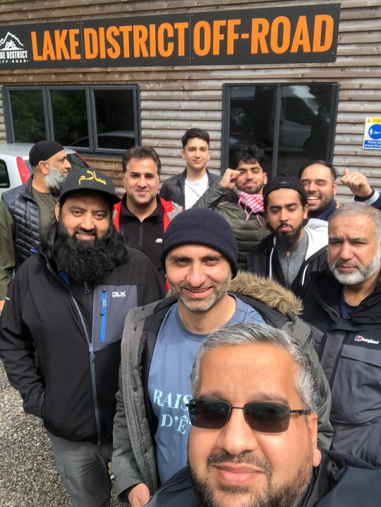
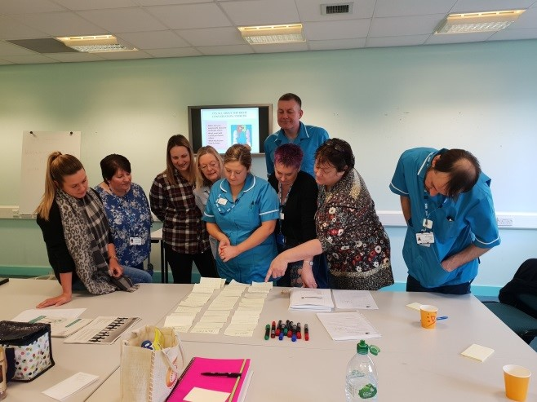
Why ABCD in Leeds
Leeds City Council's priorities and values
Diverse Third Sector and investment in
Third Sector infrastructure
Strong foundation of community development
Strength based approach to social care
Notes:
In 2012 officers attended a conference about asset based community development that talked about the value of building connections in the community. This coincided with our work to develop strength based social work.
Why ABCD made sense to the Council:
- Strength based social care - with an emphasis on personalisation and prevention.
Aligned to LCC priorities and values - 3 pillars underpinned by commitment to building stronger, resilient communities
Long track record of working with communities to build on.
Diverse (geographically and range of organisations) Third Sector. We've consistently invested in Third Sector infrastructure.
The development of ABCD coincided with the austerity agenda and while economic arguments were made about the financial benefits of community led activity, more than this, there was a backing of the principle that shifting power to communities was the right thing to do.

Slide 19
The Leeds ABCD Model
DISCOVER
CONNECT
MOBILISE
COMMUNITY BUILDERS
COMMUNITY CONNECTORS
COMMUNITY LED INITIATIVES
Discovery conversations
Asset Mapping
Connecting People
Connecting Assets
Connecting Ideas
Small Sparks
Leading by stepping back
Notes:
So our model evolved with these distinct elements:
Firstly our Pathfinder sites - we fund local community organisations with £25k per year to:
Employ a community builder who will develop an asset map and find community connectors
Run a small sparks pot to fund good ideas from the community
We also support the pathfinders to learn from each other through regular training and networking events and an induction programme for new sites led by LS14 Trust.
Currently we have 13 pathfinders across the city that are now working in an asset-based way, each covering a population of approximately 5,000-10,000, with 5 new ones that started in Jan 2022.
We have tested different approaches to the ABCD pathfinder site:
- We have had sites with a specific focus on Learning Disability and Carers
- We are currently funding a site with a focus on working alongside the Gypsy, Roma and Traveller community and a site hosted by an arts-based organisation.
- we are in the process of developing a partnership with a Tenant Management Organisation.
Over time, we have developed a clearer rationale for selecting areas:
The existing social infrastructure - we have targeted areas with limited community development activity and with potential partners who are willing to adopt the ABCD approach
Levels of deprivation
Alongside the pathfinders we have invested in:
Training: We have provided a broad ranging training offer largely aimed at the Third Sector and public sector. 2 years ago Cormac Russell led sessions for our Commissioners in Adults and Health to look at how they could take an asset based approach to their work. This year we delivered an introduction to ABCD to over 300 LCC staff and we are in the process of delivering training on ABCD to each of our 19 Local Care Partnerships.
Networks - we have a Council wide group that has brought together officers to share their learning and support the use of ABCD in different service areas from Physical Activity to Libraries to Commissioning.
Raising the profile of our work - to generate more interest and collaborators to develop the work.
Evaluation - to build the case for investment.

Slide 20
Leeds Beckett University: Evaluation of Leeds ABCD (July 2021)
Evaluation framework
Individuals and communities are better connected
Communities identify and work to bring about the changes they want to see
People have good friends
Social return on Investment
Between £5.27 and £14.02 of social value returned for every £1 invested
Notes:
In 2019 we commissioned Leeds Beckett University to support the Council to build an evidence base for ABCD. Jane South, Professor of Healthy Communities, worked with LCC and the pathfinder sites to co-produce a simple Evaluation Framework with 3 outcomes.
Jane's team then completed an in depth, mostly qualitative, research study involving in depth interviews with community builders, group discussions and analysis of monitoring data. In the 18 months from April 2019-September 2020 the research showed:
Better connected – 310 community connectors, 68 new groups /Individuals
Strong evidence that individuals and organisations are better connected. Social connections were formed through groups, social activities and use of public spaces to meet people. 68 new self-sustaining groups, linked to ABCD, were formed. There is evidence that facilitating connections led naturally to stronger community networks, that people were signposted to other support, services, and local activities and that connections with local organisations and those further afield were made. There were also examples of greater community cohesion, with different generations coming together and communities being more inclusive of people with disabilities.
Bringing about change – 48 small sparks awarded
Strong evidence for the pathway to community change with clear links between early asset-based conversations and later community action. There are many examples of positive community action bringing about changes in the neighbourhoods involved. The research highlighted examples where individuals had been motivated to develop ideas, had been inspired and felt they had more confidence to take action in relation to what they felt was important in their neighbourhood.
People have good friends
There is promising evidence that friendships were made within groups and supportive relationships were formed. The research shows the range of opportunities created for people to join in and connect with others and evidences that confidence, independence and wellbeing grew as people engaged with others.
The researchers also tested a way to measure the social return on investment and estimated that this is between 5.27 and 14.02 for every £1 invested.

Slide 21
Key findings
There is strong evidence that ABCD works in different communities and contexts
There is promising evidence regarding the Community Connector role
There is strong evidence on strengthening local groups and new community activities.
There is promising evidence of friendships, with a plausible causal chain from foundations to meaningful relationships.
There is strong evidence for better social connections.
There is strong qualitative evidence on the typical pathway to community change with clear links between early asset-based conversations with later community action.
There is promising evidence on community change.

Slide 22
Ingredients for Success
Pathfinders
Community Builder
Known and trusted
Supported by peers / mentors
Neighbourhood Organisation
Established broad role in community
Understanding / valuing CB role
Practicalities
Place to meet
Small sparks funding
City Council
Leadership support
Culture of permission / innovation
Willingness to cede control / accept risk
Notes:
The LBU research also identified what was important to help make Asset Based approaches work:
Community Builders needs to have time to build relationships and to become known and trusted.
Demanding role – need support from other CBs / organisations.
The interviews undertaken by Leeds Beckett highlighted the importance of:
High level of support for ABCD at the Council - clear, visible leadership / championing of the approach
A culture that enabled the programme to be tested.
The Council's willingness to give up a degree of control and trust people in communities and move away from a more bureaucratic approach.

Slide 23
Four level approach in Leeds
Grassroots/ community level
Practitioner level
Service level
Whole system level
Notes:
Through our learning we have developed a four levelled approach to how we can drive the ABCD model with our partners in the third sector but also how we as a council cultural shift our strategic vision and operating models in an asset-based way.
1: Building resilient individuals, families, and communities- ABCD model – Time Banking
2: Working in different ways to help individuals and families find solutions that build on their strengths and assets – Strength Based Social Care, Better Conversations, Local Care Partnerships
3: building flexible, empowering, and responsive services that are delivered in new and innovative ways – Inclusive commissioning that draws on the expertise of communities to prioritise outcomes that are important to them
4: System Influence/change Leadership to develop and implement the vision of asset-based approaches and recognising that part of the solution to our challenge rests in collaborative working with the wider public and private sectors.

Slide 24
Working on a whole system
ABCD supports Leeds Best City Ambition
ABCD Steering group
Asset Based Leeds City Council Staff Learning Network
ABCD Training and Learning Collective
Building our relationship with the Third Sector in Leeds
ABCD plan on a page

Slide 25
http://www.abcdinleeds.com/
ABCD@Leeds.gov.uk
Twitter: @ABCD_in_Leeds

Slide 26
Strengths-based commissioning/provision
Include asset-based approaches in service specifications
Developing Small Support provision for complex needs
Community Catalysts – micro enterprises
Re-imagining day opportunities
Adopt relationship-based commissioning
“Ideas that change lives” programme to pump-prime innovation
Proliferation of ABCD approaches across the city
Pilot of change home care

Slide 27
From Home Care to a Community Health & Well-being Service
A future based on partnership and collaboration
Phase 2 pilot: Joint commissioning of community-based support with Leeds Community Healthcare NHS Trust with 2-3 providers in a geography based on natural neighbourhoods which is 10% of total provision, c 200 people.
Stepping away from traditional contracting arrangements: the Council, NHS, Third sector and private care providers will collaborate not compete to deliver home based care services, creating a partnership around the person
Trusting the professional judgement of providers to adjust packages up and down within agreed parameters, giving greater autonomy to care workers

Slide 28
CHWBS (2)
Personalised holistic care
Three-way support planning between the social worker, care provider and citizen
Moving away from time and task, focused on staying well at home, promoting independence with the support of OTs, reconnecting with family, friends & community
Providers to deliver delegated health care tasks on behalf of the NHS Community Provider as well as social care tasks
Third sector Enhance programme to act as "proxy family

Slide 29
CHWBS 3
Better deal for care workers
Contract based on paying for whole shift – unit cost adjusted
"Down time" to be used for the benefit of citizens, training, community networking, attending MDTs
Greater autonomy and respect for the knowledge care workers have of the people they support
Developing new skills but also supported by Council Occupational Therapist
Neighbourhood model encourages hyper local recruitment and more walking rounds – less reliant on car drivers

Slide 30
Co-produced
Whole process overseen by a Stakeholder Board
People who use services, carers, Third Sector, Trade Unions and Providers involved
Number of consultation events held
Helped shaped the content of the specification
Helped shaped the contracting approach

Slide 31
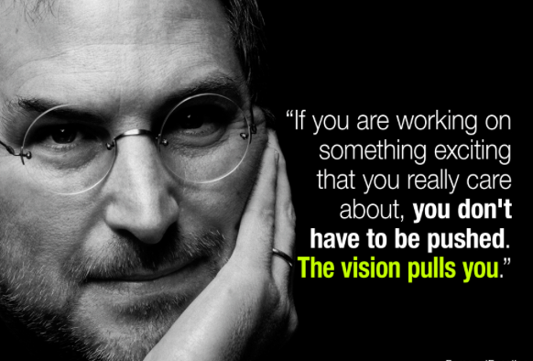

Slide 32
Thank you for listening!
Any questions?

