Slide 3
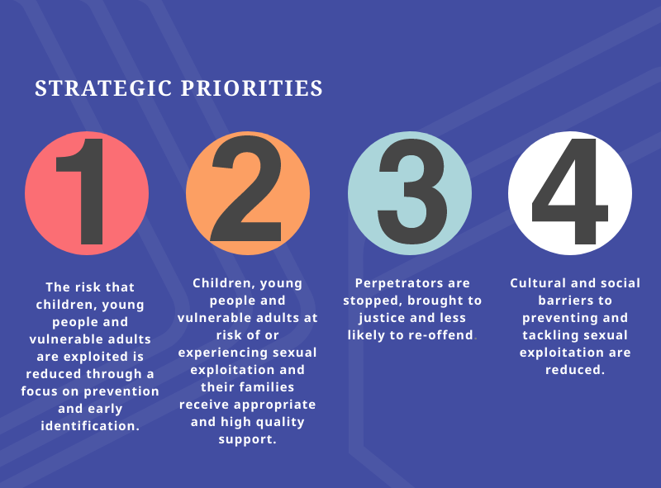

Slide 5
The Strategy was approved by the Integration Joint Board on 16th September 2020. The Sexual Exploitation Strategy Implementation Group will take forward the Implementation Plan.
https://www.south-ayrshire.gov.uk/health-social-care-partnership/strategy.aspx
If you have any comments on the strategy contact: sahscp.consultation@south-ayrshire.gov.uk

