Slide 1
The Promise Workshop
Notes:
explain process from the promise to the briefing paper to the plan
Care experience edges of care
Kinship residential foster care looked after at home previously in care

Slide 2
Children must be listened to and meaningfully and appropriately involved in decision-making about their care, with all those involved properly listening and responding to what children want and need. There must be a compassionate, caring decision-making culture focussed on children and those they trust.
Where children are safe in their families and feel loved they must stay – and families must be given support together, to nurture that love and overcome the difficulties which get in the way.
Where living with their family is not possible, children must stay with their brothers and sisters where safe to do so, and belong to a loving home, staying there for as long as needed.
The children that Scotland cares for must be actively supported to develop relationships with people in the workforce and wider community, who in turn must be supported to listen and to be compassionate in their decision-making and care
Children, families and the workforce must be supported by a system that is there when it is needed. The scaffolding of help, support and accountability must be ready and responsive when it is required.
Notes:
Foundations

Slide 3
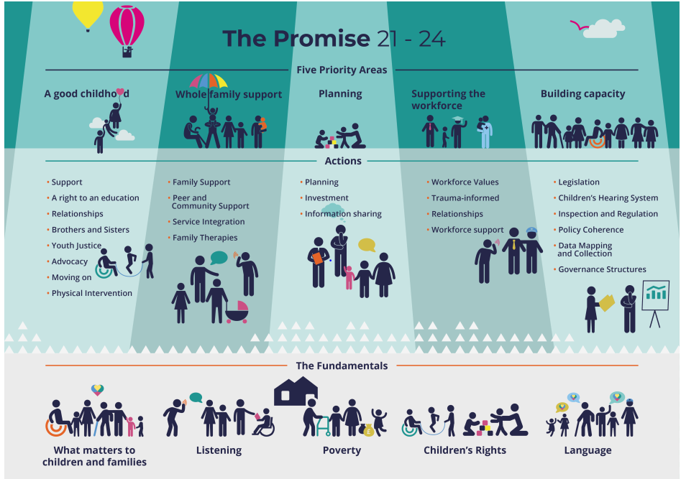
Notes:
The plan 2021-24
Here's what the fundamentals really mean
At all stages in the process of change what matters to children and families must be the focus
Organisations will be able to demonstrate that they are working from their perspective rather than the perspective internal to the system
Listening
Organisations that have responsibilities towards care experienced children and families, and those on the edge of care will be able to demonstrate that they are embedding what they have heard from children and families into the work that they are doing to #KeepThePromise
Poverty
South Ayrshire will be able to demonstrate how they are ensuring that they play their part in mitigating the impacts of poverty
Children’s Rights
is for all children in or on the edge of care, no matter their setting of care or their legal status. It is imperative that Scotland does not divide the population to specific minority groups. This does not mean ignoring the huge diversity of experiences that are represented within the ‘care community’. Rather, it means that careful attention must be paid to the experiences of every child and care experienced adult
Language
Organisations that have responsibilities towards care experienced children and young people will be able to demonstrate that they are embedding destigmatising language and practices across the way they work.

Slide 11
Key Questions to Consider
To what extent can your service demonstrate that they are working from the perspective of those who use services rather than a perspective that suits the current system?
How can you and the service you represent take a more flexible, whole family approach to supporting children - Who might you need to work with to make the change happen

