Slide 1
Invigor8 Falls Prevention Programme
Healthy and Active Rehabilitation Programme
“If physical activity were a drug, we’d talk about it as a miracle cure”
Quote by Professor Dame Sally Davies, Chief Medical Officer for England and Chief Medical Adviser to the UK government (2017)
Janey Anderson, Team Leader
Sport and Leisure,
South Ayrshire Council

Slide 2
Considerations
Pressures increasing across NHS and Health and Social Care services
Life expectancy of South Ayrshire’s older population set to increase
Invigor8 evidence based exercise programme assist in the prevention of falls or fear of falling in the over 60’s
HARP exercise programme assist people with cardiac, stroke, cancer, pulmonary, diabetic medical history to self-manage their health via increased physical activity and exercise.
The programmes provide health benefits physically, mentally and socially and assist in maintaining or improving health and independence.

Slide 3
Invigor8, falls prevention exercise programme, established in 2006, is an evidence-based, pan Ayrshire model of exercise classes for the over 60’s to improve or maintain a person’s strength, balance, flexibility, endurance and build confidence.
More people are admitted to hospital for falls related incidents than any other condition. Having a fall can cause soft tissue damage, fractures or even death. Falls, or being fearful of having a fall can also cause loss of confidence and people may become isolated.
Exercise classes throughout South Ayrshire; maintaining people’s independence, improving or maintaining functional ability to do every day tasks, socialising to improve mental health and reduce loneliness.

Slide 4
The Healthy and Active Rehabilitation Programme (HARP)
A model of rehabilitation for people living in Ayrshire with multimorbidity. Includes people with cardiac, stroke, cancers, pulmonary or diabetic medical history.
Established in 2015 HARP is a multi-agency health and social care team. Collaborative approach to produce a generic approach to rehabilitation spanning all three Ayrshire health and social care partnerships.
HARP has been designed as a flexible 4-tiered model with a focus on supporting services and service users to develop the confidence and capabilities to self-manage their conditions.
South Ayrshire Council’s Sport and Leisure team provide Tier 2, specialised rehabilitation exercise classes and activities providing lifelong self-management skills to maintain and /or improved health physically, mentally, and socially.

Slide 6
Classes available in South Ayrshire
15 Invigor8 classes
15 HARP / Weigh to go classes
3 Gentle Movement classes Combining Tai Chi and Qigong
4 Health Walks 1hr long, volunteer led walks.
1,043 pay as you go members
127 Health Memberships

Slide 7
Classes are delivered by highly qualified, Health and Fitness Instructors. Qualifications include:
Exercise Referral Qualification (Level 3)
BACPR - British Association for Cardiovascular Prevention and Rehabilitation (Level 4)
CanRehab – Cancer rehabilitation (Level 4)
PSI – Postural Stability Instructor (Level 4)
Obesity and Diabetes Prevention Instructor (Level 4)
Weigh to go, healthy weight programme devised by NHS

Slide 8
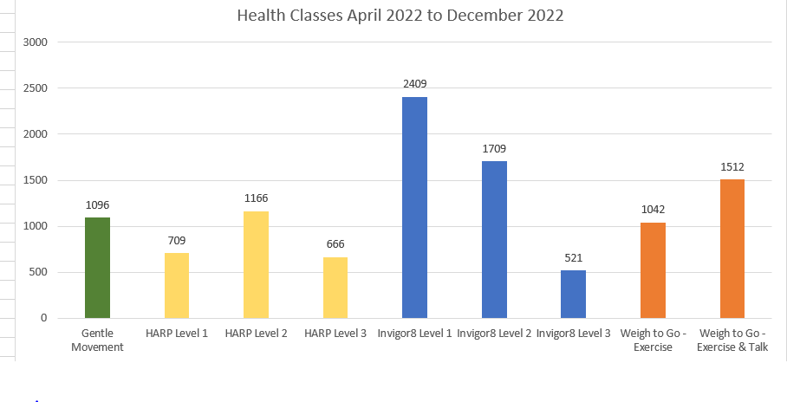

Slide 9
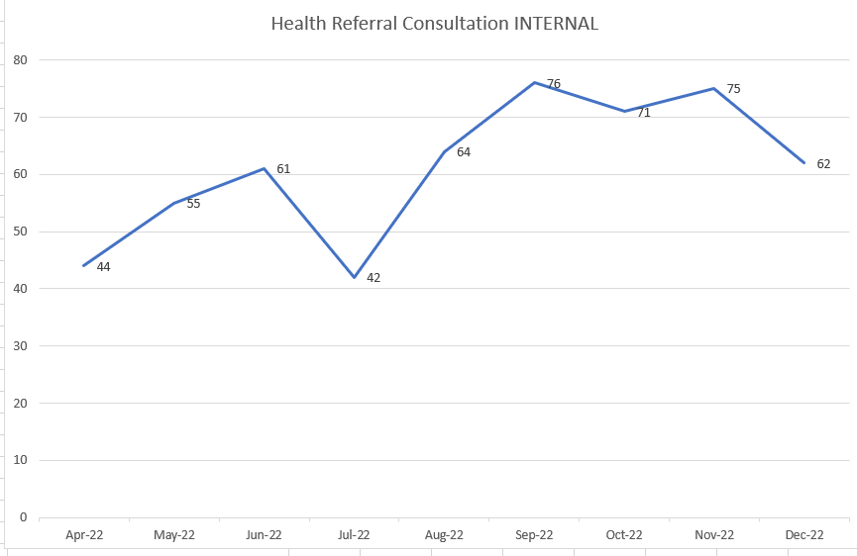
Total referrals Apr – Dec 2022 = 550
Referrals by health professionals
Form for cardiac, stroke, complex medical history
Vouchers handed out by health professionals, community link practitioners
Self referral

Slide 10
Squat challenge comments
“Before participating in the squat challenge I had to go up my stairs on my bottom. Now I can walk up the stairs. Feels so good.”
“I had to go up stairs sideways, one step at a time with 2 hands holding onto the handrail. I can now walk up the stairs one at a time and don’t even think about it.”

Slide 11
Elizabeth Invigor8
“Since joining this class I have experienced improvements in my physical strength and stamina. I find that I can walk further than previously. Before I needed to pause for a rest.”
“I have 14 stairs at home which I can now manage without stopping for a rest most days.”
“Feeling more fit physically is a morale booster. Rather than feeling I was going to become weaker I am now encouraged by regaining some of my strength and can only hope that this will continue to improve.”
“On cold, wet winter days it would be all to easy to sit at home in front of the tele’. Having somewhere to go, where you are always greeted warmly and given encouragement in the company of others is a great incentive.”

Slide 12
Christine Invigor8
“The mental benefits are immense. The exercise stimulates my brain and helps with companionship easing my loneliness and it's good fun.”
Jacqui Gentle Movement
“I have found the exercise very helpful. My movement and balance are improving every week. Hoping to try invigor8 class next. I had a very bad dose of Covid a couple of months ago and I was finding it very difficult to catch my breath. I started using the breathing techniques I am learning in the gentle movement class which was a great help. Thank you.”
Doug HARP
“Having had a triple heart bypass I am keen to improve my health. The classes are excellent for giving me different exercises that I would not do at home. I feel the benefits after only six weeks attending and have been encouraged so much I have signed up for more classes.”
“Knowing I can push myself under expert supervision has improved my personal assessment of how well I can become. I return from classes feeling far more positive about life and personal health.”

Slide 13
